Slide 1

Articles
Tematická oblast | Slovní zásoba a gramatika
Datum vytvoření | 14.7.2013
Ročník | 3.-4., septima-oktáva
Stručný obsah | Materiál procvičuje použití členu neurčitého, určitého a nulového u obecných podstatných jmen a zeměpisných názvů
Způsob využití | Vhodné jako doplněk při probírání britských reálií, resp. Skotska, dále je možno zaměřit se na fráze typické pro tento typ textu
Autor | Dana Mynářová
Kód | VY_32_INOVACE_04_MYN02
Gymnázium a Jazyková škola s právem státní jazykové zkoušky Zlín

Slide 2
Complete the text with indefinite or definite articles, or nothing. Explain the meaning of the words in bold.
Scotland is ___ land of many contrasts. Most significant is ___ difference
between ____ Higlands and ____ Lowlands.
Scotland embodies __ huge variety of ____ landscapes in ___ relatively small
space. The features are perhaps not as large as their equivalents on ___ great
continental landmasses, but ___ mountains are no less dramatic.
___ western coastline is washed by the mild waters of ___ Atlantic Gulf
Stream, while ___ more fertile eastern shores are frequently exposed to ___
biting winds and ___ cold fogs.
You can see many places that make ___ country unique. Some, like ___ Forth
Rail Bridge or ___ Ben Nevis, need no introduction; others, less well-known,
like ___ fishing village of Portnahaven, are here for you to discover.

Slide 3
Answer key - articles
Scotland is a land of many contrasts. Most significant is the difference between the Higlands and the Lowlands.
Scotland embodies a huge variety of landscapes in a relatively small space. The features are perhaps not as large as their equivalents on the great continental landmasses, but the mountains are no less dramatic.
The western coastline is washed by the mild waters of the Atlantic Gulf Stream, while the more fertile eastern shores are frequently exposed to biting winds and cold fogs.
You can see many places that make the country unique. Some, like the Forth Rail Bridge or Ben Nevis, need no introduction; others, less well-known, like the fishing village of Portnahaven, are here for you to discover.

Slide 4
Answer key - synonyms
to embody = comprise (zahrnovat)
features = stuctures or patterns related to the Earth, e.g. land, mountains, valleys
mild = gentle, temperate, not cold or extreme
shores = coast, a land along the edge of a sea
biting = unpleasant

Slide 5
Phrases to remember
a huge variety of landscapes
in a relatively small space
fertile shores
be frequently exposed to
places that make the country unique
significant differences
some places need no introduction, some are here for you to discover

Slide 6
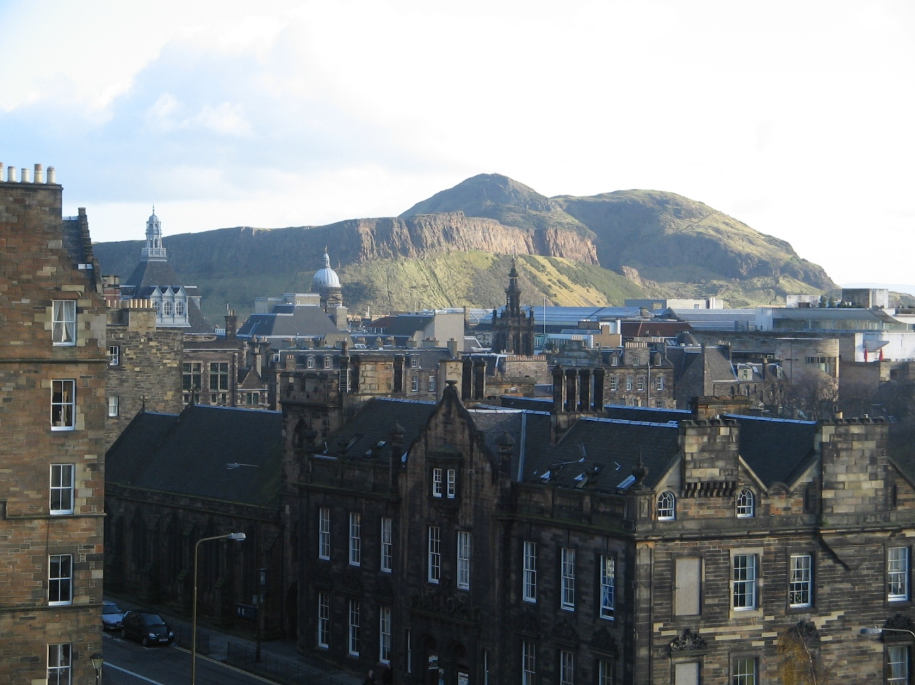
Describe the picture using the vocabulary in the text

Slide 7
Zdroje
COLIN BAXTER: Scotland. 1. vyd. Colin Baxter Gift Book Series,
1999. ISBN 9780521603782, s. 98-99
archiv autorky

