Slide 1

Jobs, Careers, Business
Tematická oblast | Slovní zásoba a gramatika
Datum vytvoření | 28.7.2013
Ročník | 2., kvinta, úroveň B1
Stručný obsah | Materiál je zaměřen na opakování slovní zásoby na téma zaměstnání
Způsob využití | Procvičování nebo testování slovní zásoby 3. lekce učebnice Maturita Solutions Intermediate 2nd edition
Autor | Mgr. Dana Mynářová
Kód | VY_32_INOVACE_04_AMYN05
Gymnázium a Jazyková škola s právem státní jazykové zkoušky Zlín

Slide 2
Use the expressions to describe the jobs in the pictures
shift work
do paperwork
be in charge of
menial job
tedious
skilled, unskilled
deal with the public
What can you say about the people in the pictures?
rewarding
challenging
stressful
manual
well/badly-paid
work on one´s own
work in a team
Are these jobs carried out by both men and women?

Slide 3



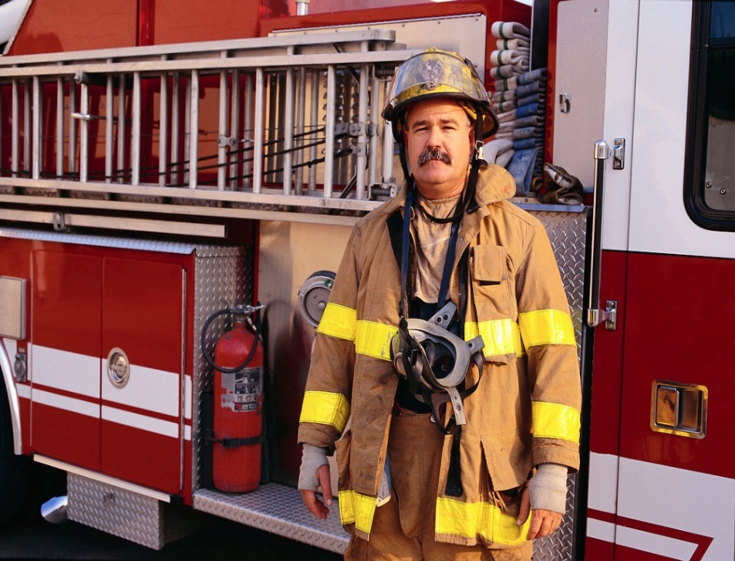

Slide 4
Possible answers
Fire-fighter – challenging, rewarding, stressful, work in a team
Teacher – skilled, do paperwork, stressful
Doctor – skilled, stressful, work in shifts, do paperwork, challenging, rewarding
Gardener – manual, work on one´s own, sometimes tedious
Doctor – skilled, stressful, work in shifts, do paperwork, challenging, rewarding
Students´ own answers

Slide 5
Complete the phrases with the corect forms of the verbs make, go, set, take or do
He ……… up a business selling shoes and footwear in 1996, ………. into partnership with his younger brother in 1999. They ……………. really well and ……………. a profit. They decided to expand and …….. on more staff.
Unfortunately they underestimated the competitors and ……… a loss during the economic recession. They nearly ……. bankrupt but after 2011 their sales figures improved. At the moment they ………. a lot of business in the area.

Slide 6
Answer key
He set up a business selling shoes and footwear in 1996, went into partnership with his younger brother in 1999. They were doing really well and made a profit. They decided to expand and took on more staff.
Unfortunately they underestimated the competitors and made a loss during the economic recession. They nearly went bankrupt but after 2011 their sales figures improved. At the moment they are doing a lot of business in the area.

Slide 7
Zdroje:
obrázky – Microsoft Office.com (klipart)
archiv autorky

