Slide 1


Interesting places - word formation, use of English
Tematická oblast | Slovní zásoba a gramatika
Datum vytvoření | 4. 8. 2013
Ročník | 1.-3. ročník, kvinta
Stručný obsah | Materiál je zaměřen na doplňování, respektive tvoření slov
Způsob využití | Materiál je možno použít nejen k procvičení, resp. testování slovní zásoby, ale i při probírání tématu cestování, v počítačové učebně studenti vyhledávají informace na internetu
Autor | Mgr. Dana Mynářová
Kód | VY_32_INOVACE_04_AMYN09
Gymnázium a Jazyková škola s právem státní jazykové zkoušky Zlín

Slide 2
Complete the text with one word
When tourists head south from Madrid, it's generally …….. Granada, Córdoba, Sevilla, or the Costa del Sol. The big cities ……….. their urban charms, but the Costa del Sol is a concrete nightmare, worthwhile only ………. a bad example. The most Spanish ………. about the south coast is the sunshine — but that's everywhere. For something different and ……….. authentic, try exploring the interior of Andalucía ……….. the Route of the White Hill Towns (Ruta de los Pueblos Blancos). This charm bracelet of cute villages ……… you wonderfully untouched Spanish culture.

Slide 3
Possible Answer Key
When tourists head south from Madrid, it's generally for Granada, Córdoba, Sevilla, or the Costa del Sol. The big cities have their urban charms, but the Costa del Sol is a concrete nightmare, worthwhile only as a bad example. The most Spanish thing/feature about the south coast is the sunshine — but that's everywhere. For something different and more authentic, try exploring the interior of Andalucía along the Route of the White Hill Towns (Ruta de los Pueblos Blancos). This charm bracelet of cute villages gives/offers you wonderfully untouched Spanish culture.

Slide 4
Complete the text with the correct forms of the words on the right.
Spend a night in the ………… queen of the white towns, Arcos de la Frontera.
Arcos is ………… than the other …………… hill towns but equally ………….. It consists of two towns: The fairy-tale old town on top of the hill, and the fun-loving …………. or new town. The old center is a labyrinthine ……………, a photographer's feast.
romance
large
Andalusia
atmosphere
low
wonder

Slide 5
Answer key
Spend a night in the romantic queen of the white towns, Arcos de la Frontera.
Arcos is larger than the other Andalusian hill towns but equally atmospheric. It consists of two towns: The fairy-tale old town on top of the hill, and the fun-loving lower or new town. The old center is a labyrinthine wonderland, a photographer's feast.

Slide 6
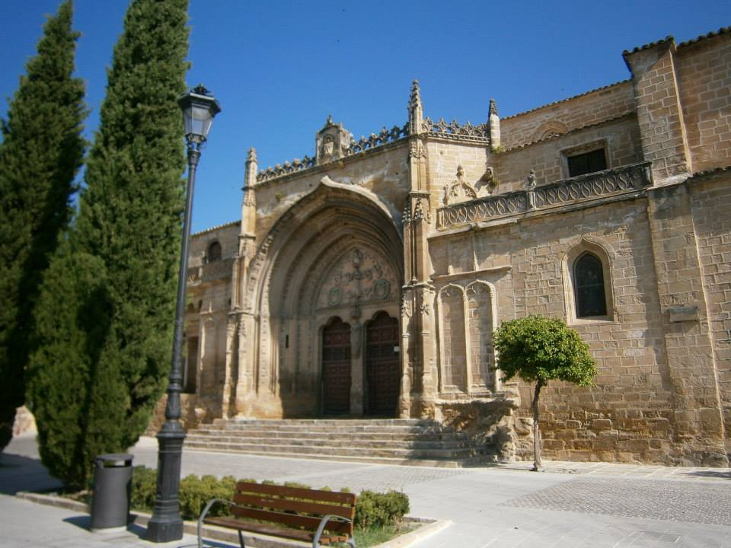
If possible, find some facts about interesting places in Andalusia on the internet
Úbeda

Slide 7
Zdroje
http://www.ricksteves.com/plan/destinations/spain/arcos.htm
archiv autorky

