Slide 1


Write a story
Tematická oblast | Slovní zásoba a gramatika
Datum vytvoření | 17. 8. 2013
Ročník | 2. - 4. ročník, kvinta - oktáva
Stručný obsah | Opakování a procvičování časů ve vypravování
Způsob využití | Ústní nebo písemné testování, např. k maturitě, opakování popisu událostí – učebnice Maturita Solutions Intermediate 2nd edition, 2. lekce
Autor | Mgr. Dana Mynářová
Kód | VY_32_INOVACE_04_AMYN19
Gymnázium a Jazyková škola s právem státní jazykové zkoušky Zlín

Slide 2
Write a story
Begin your story with the sentence:
Last summer I spent my holiday in Great Britain.
Use the pictures (not necessarily in the given order)
Use the narrative time expressions
At first, then, suddenly, after that, a few minutes (hours) later, later on, in the end … and narrative tenses

Slide 3
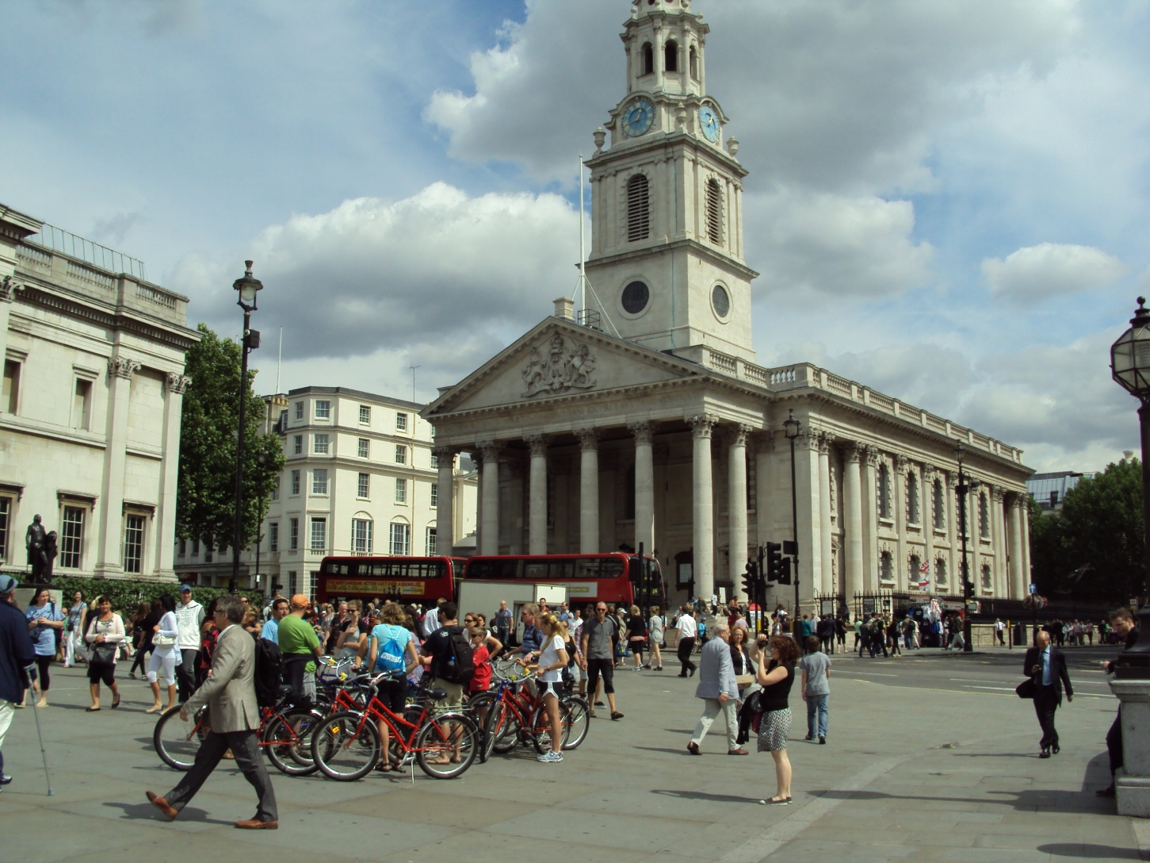

Slide 4
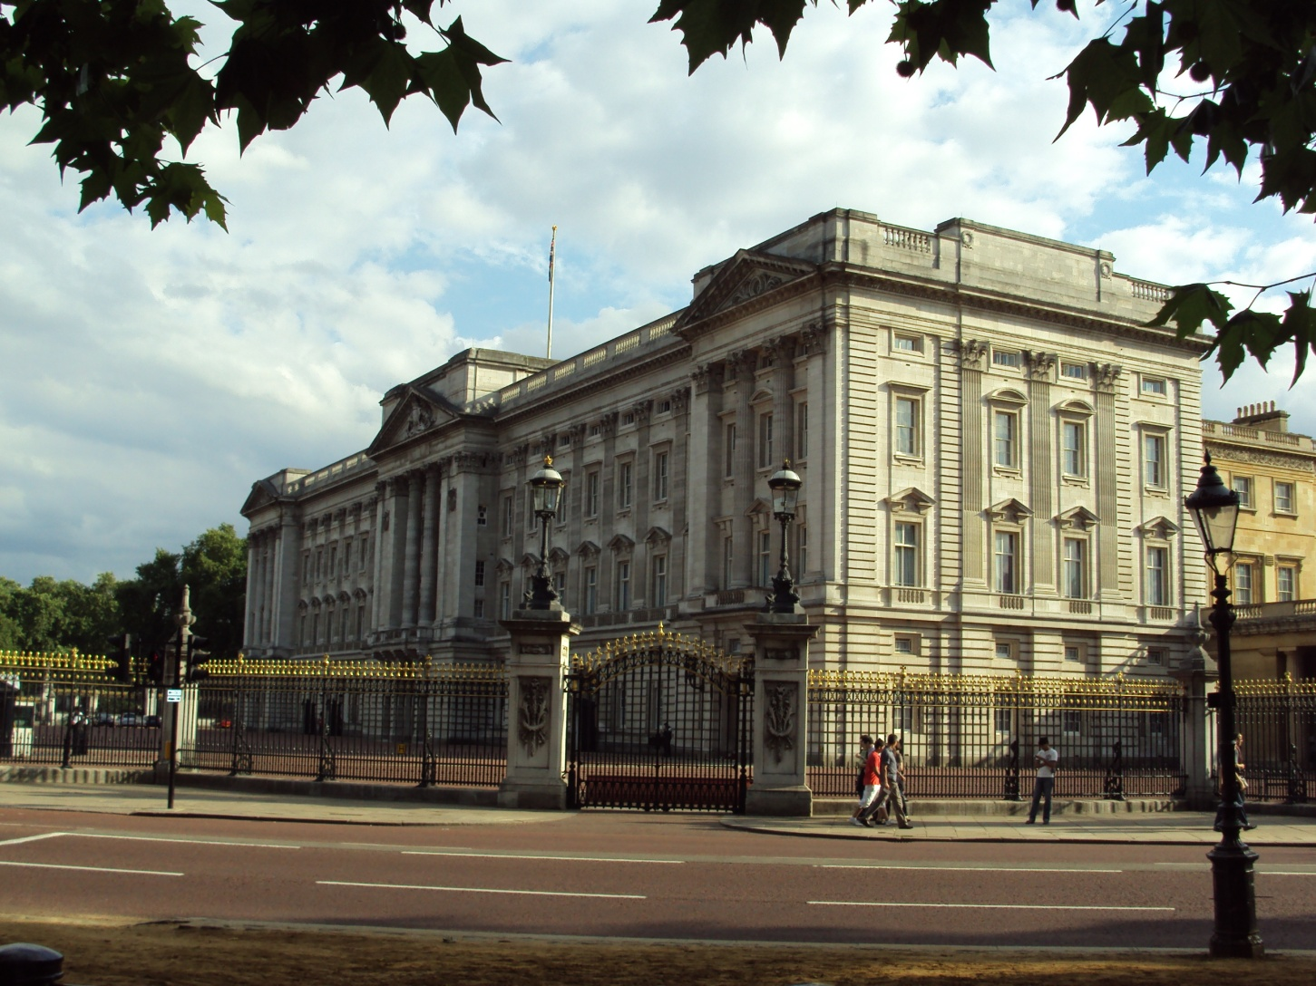

Slide 5
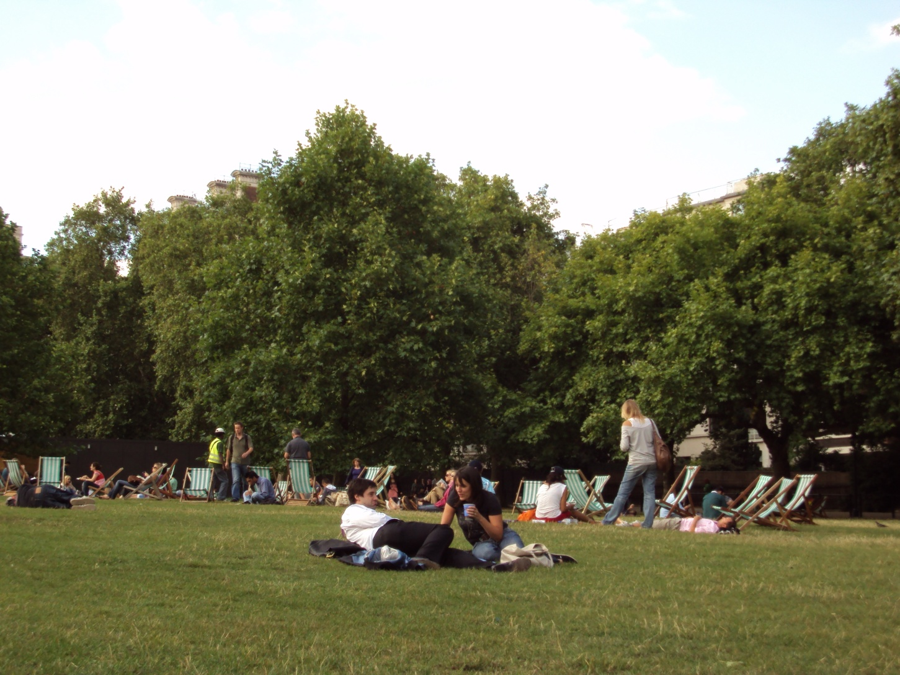

Slide 6
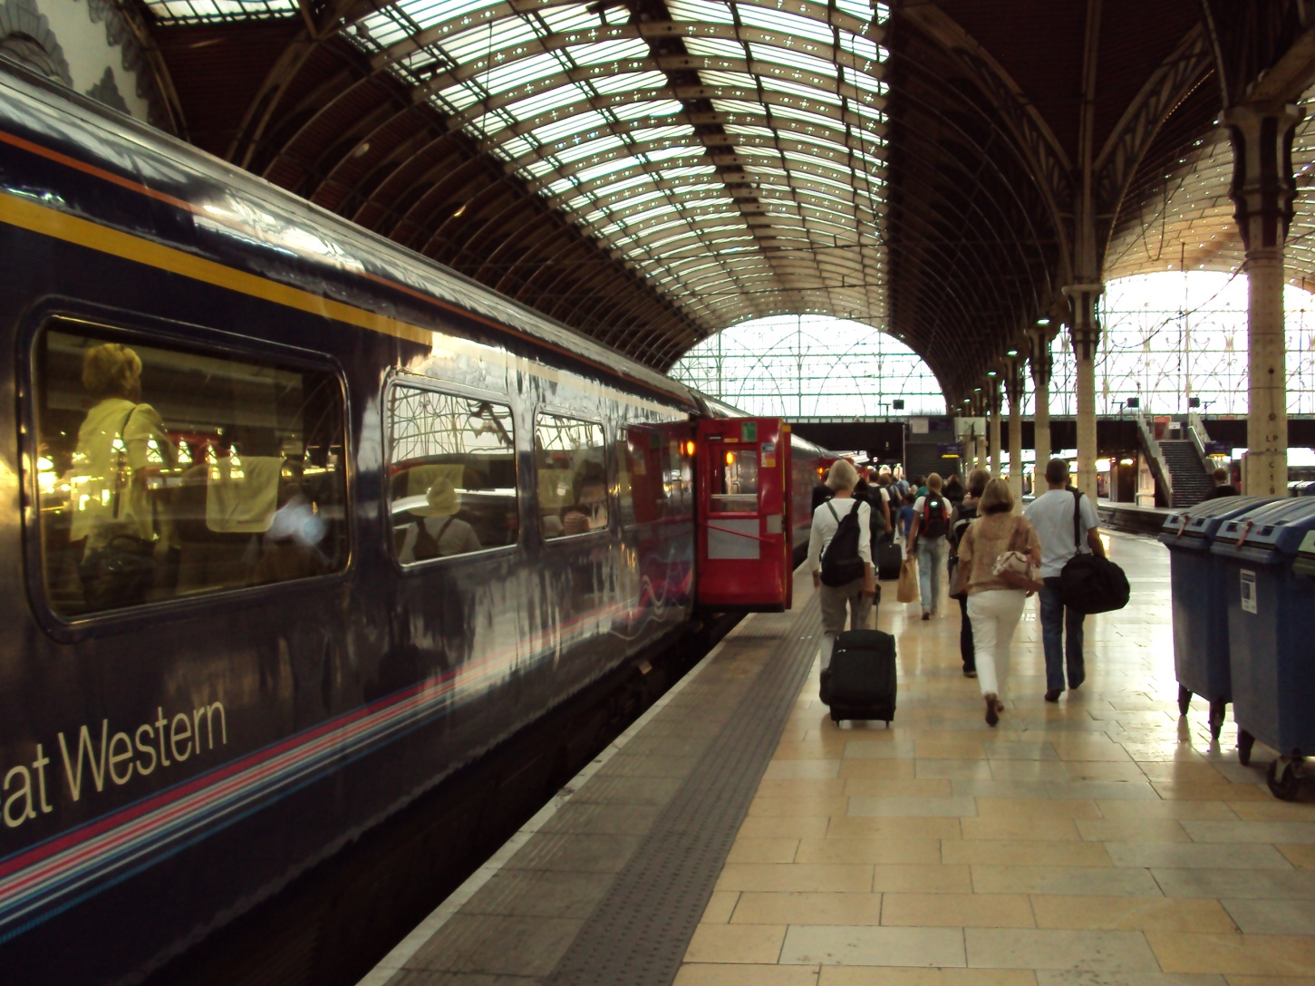

Slide 7
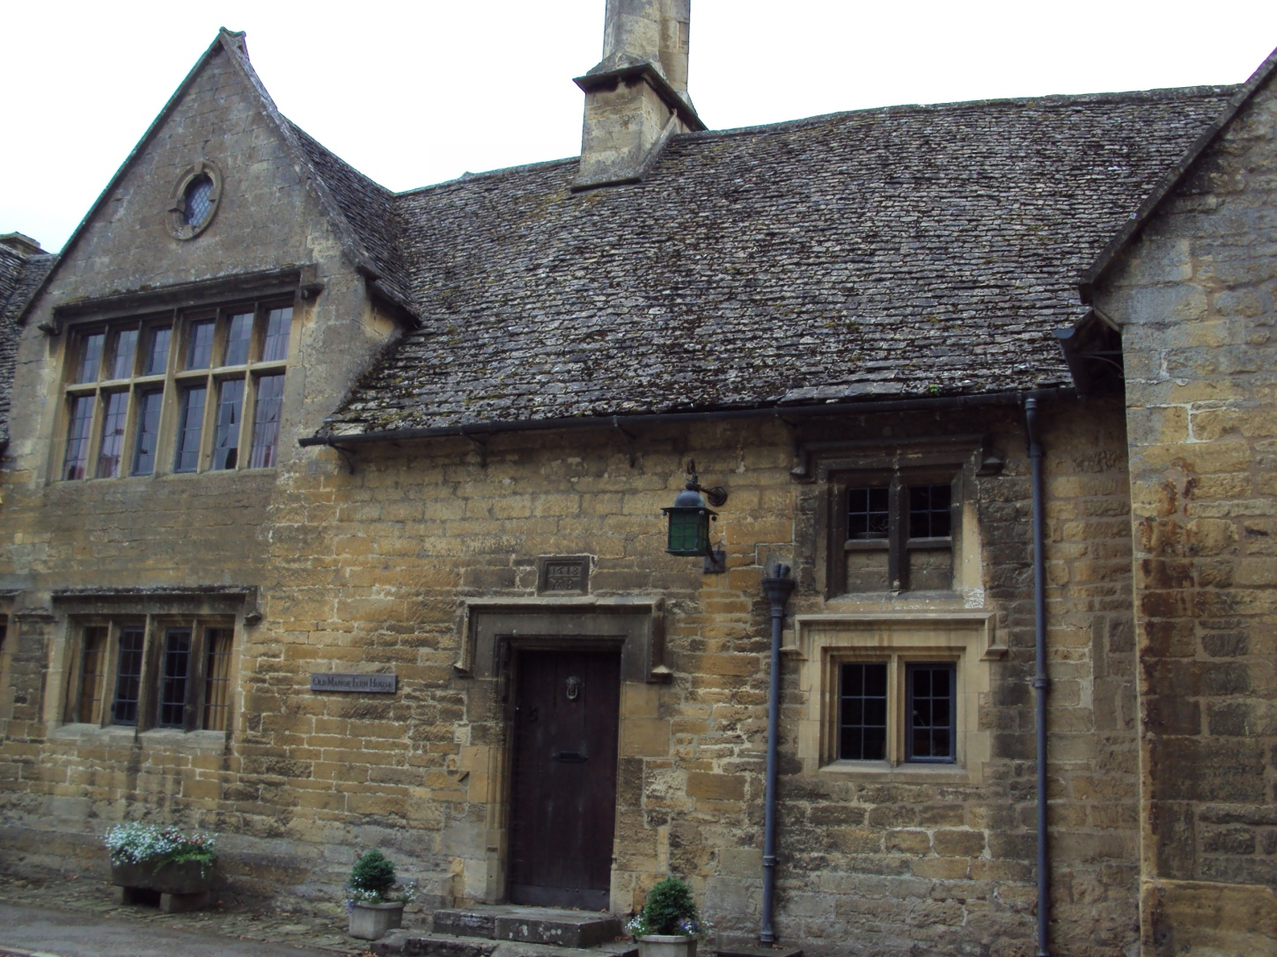

Slide 8
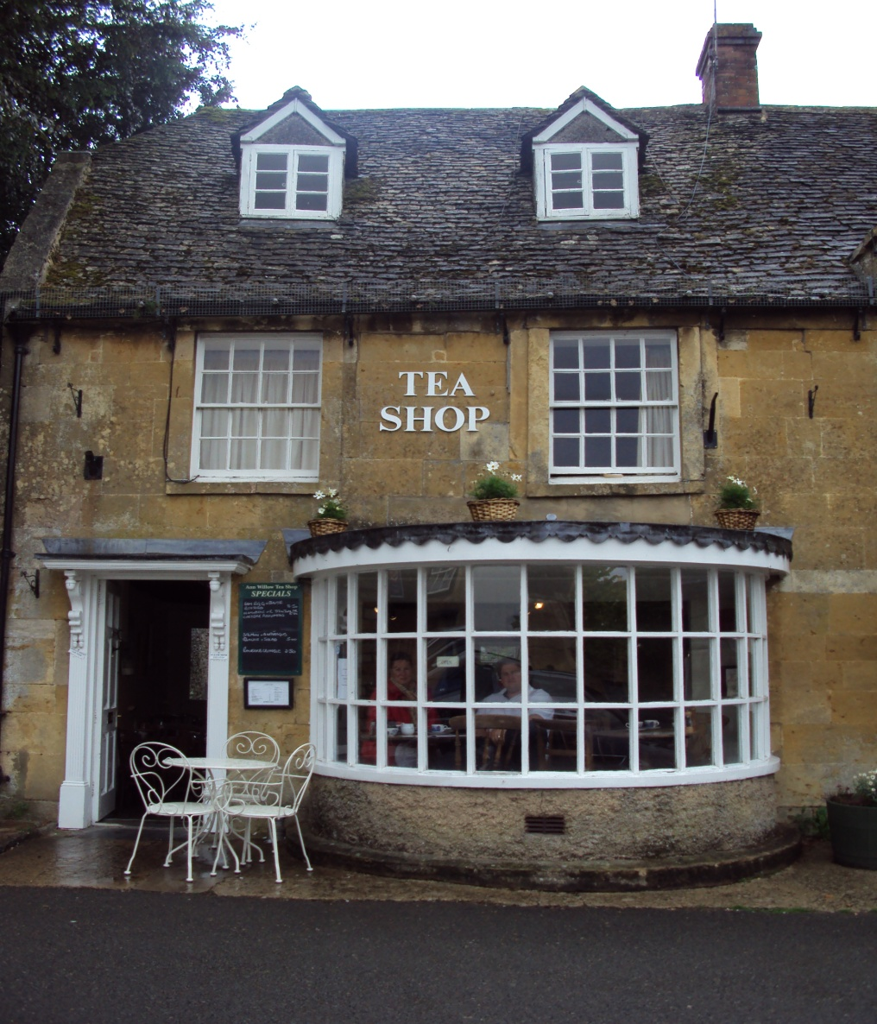

Slide 9
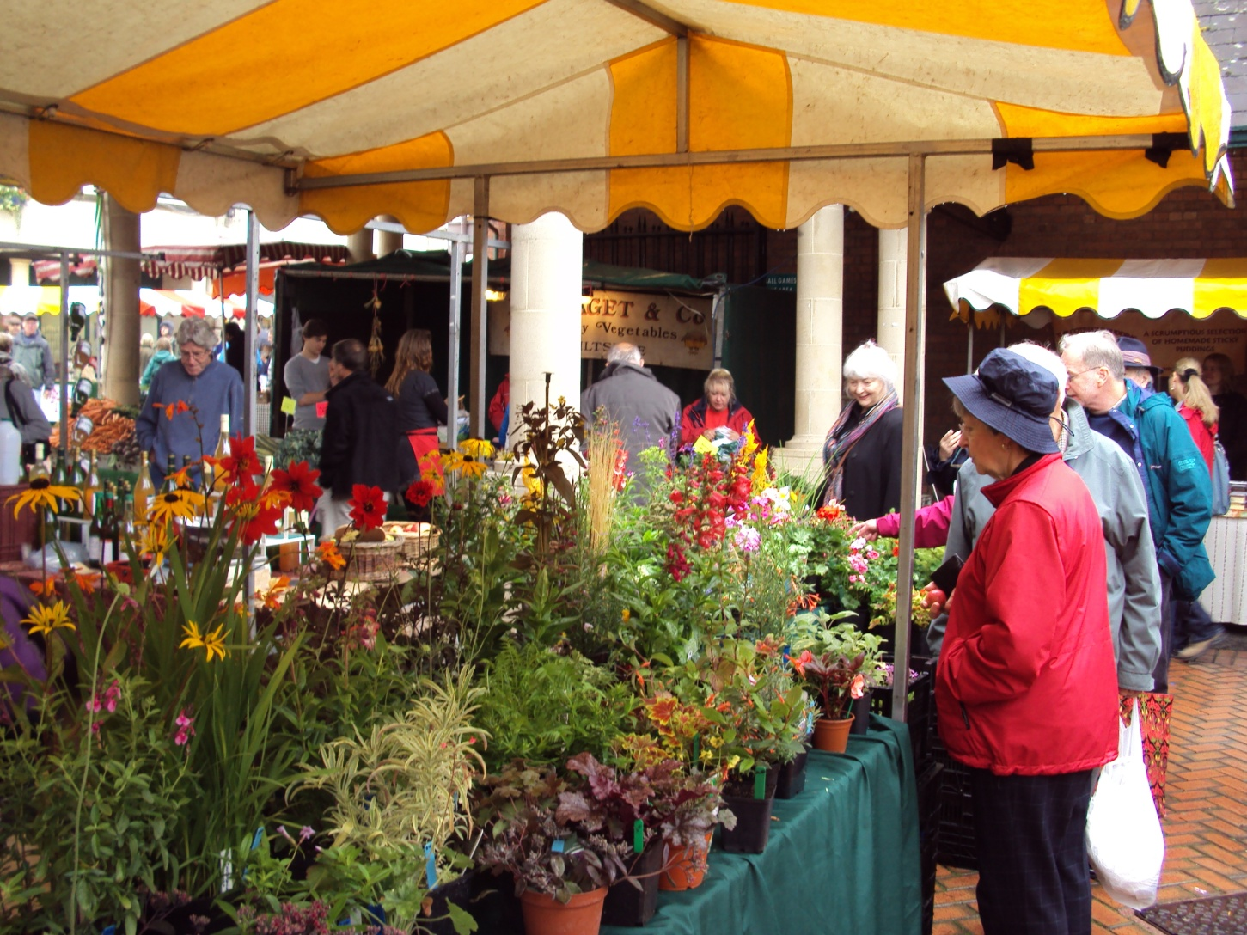

Slide 10
Possible answer
Last summer I spent my holiday in Great Britain. I had been looking forward to the trip for a long time.
When I arrived in London I headed for the National Gallery as I wanted to see some famous paintings. After that I went to Buckingham Palace where my friend was waiting for me. We had a rest in Green Park for a while and then we set off for the train journey.
Twenty minutes later we were sitting on a train to the Cotswolds, the area where my friend lives. I had a really wonderful time there.

Slide 11
For example, we visited a historic village called Painswick where there is a variety of small shops and galleries to browse around and had a cup of tea in the tea shop. I was astonished by the stone houses!
One day we decided to go to the farmer´s market in the town. I hadn´t seen so many home-made products and fresh vegetables before. My friend met there some neighbours and talked to them.
In the end of my holiday I bought some souvenirs and packed my luggage. After a couple of weeks I took a train to Paddington Station in London and then a plane to Prague. It was a fantastic experience!

Slide 12
Zdroj
archiv autorky

