Slide 1

Introduction
Tematická oblast | Angličtina: The Czech Republic
Datum vytvoření | 20. 10. 2012
Ročník | 2. - 4., sexta – oktáva, úroveň B1
Stručný obsah | Úvod k tématu Česká republika, základní geografické charakteristiky
Způsob využití | Otázky na základní informace o České republice s využitím map. Po každém snímku s otázkami následuje „vzorová odpověď“
Autor | Mgr. Jiřina Juříčková
Kód | VY_32_INOVACE_06_AJUR01
Gymnázium a Jazyková škola s právem státní jazykové zkoušky Zlín

Slide 2
Czech Republic
Introduction

Slide 3
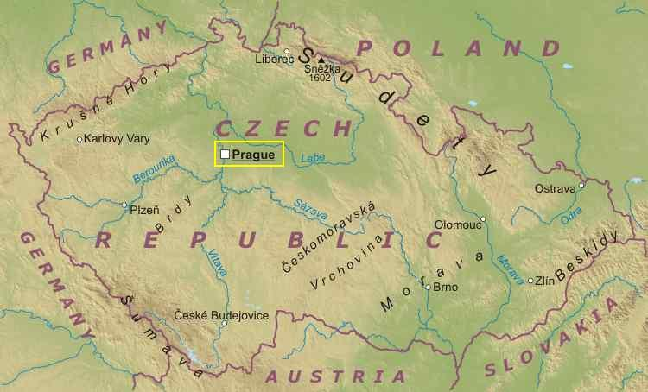
Location
What is the location of the Czech Republic?
What are its neighbours?
What are the borders formed by?

Slide 4
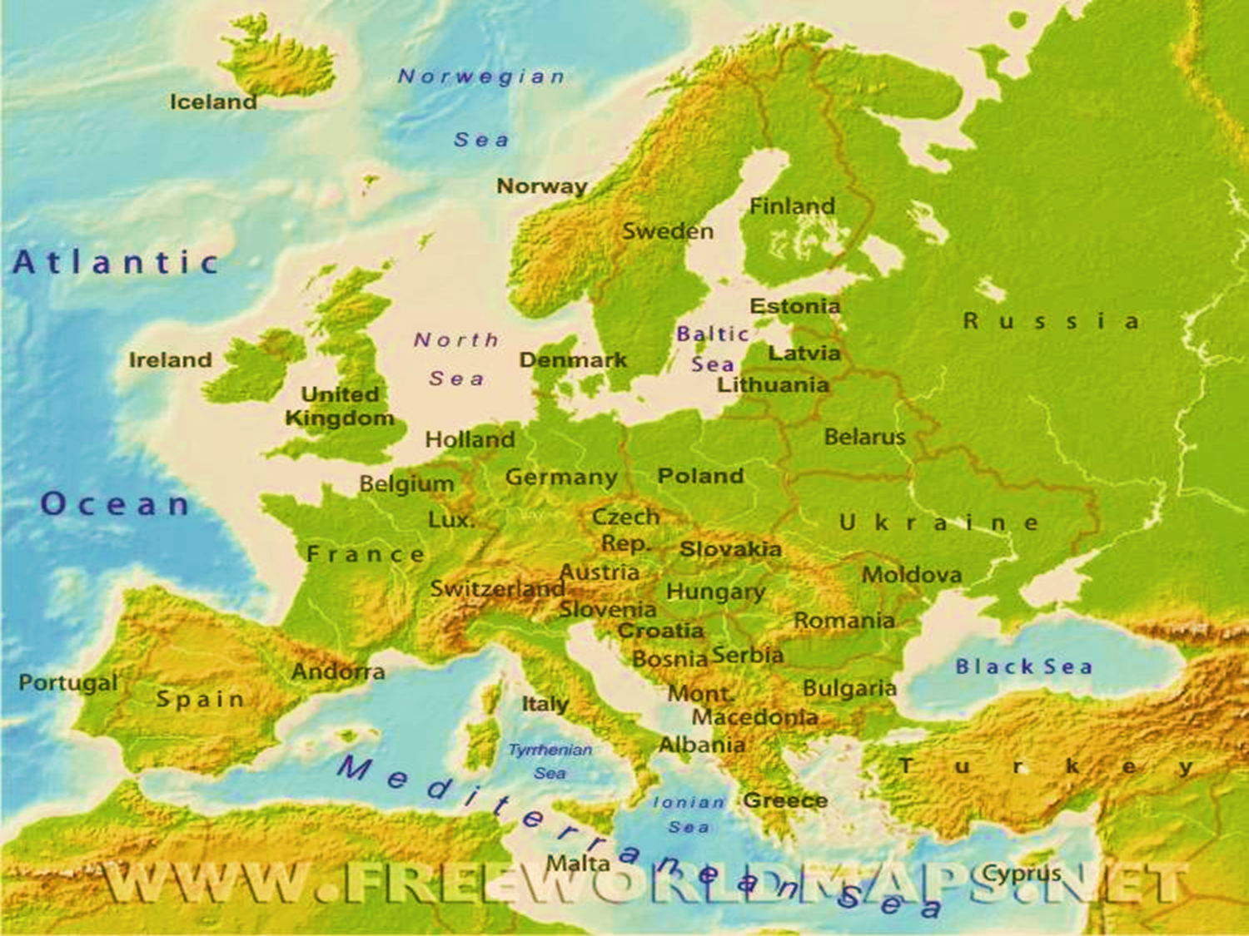
Location

Slide 5
Location
The Czech Republic is situated in the heart of Europe/in Central Europe
It neighbours Germany in the west, Poland in the north,
Slovakia in the east, and Austria in the south.
The borders are formed mainly by mountain ranges such as the Ore
Mountains, the Giant Mountains in the north, the Beskydy
Mountains and the Carpathians in the east, and the Sumava
Mountains in the south.

Slide 6



International organisations
Is the Czech Republic a member of any international organisations?

Slide 7
International organisations
The Czech Republic is a member of European Union
The Czech Republic is also a member of NATO, North Atlantic Treaty Organisation and United Nations

Slide 8
Climatic conditions
What climatic zone does the Czech Republic lie?
What is typical for this climatic zone?
What is the weather like during the year?

Slide 9
Climatic conditions
The Czech Republic lies in the temperate climatic zone.
This means there are four distinctive seasons during a year with more oceanic influence in the west. The east of the country is influenced by continental climate.
Although the climate changes due to climate change and global warming, we can say that winters in the CR are quite cold with a lot of snow and temperatures below zero. In spring the snow melts and it gets warmer. But still the weather is changeable with rain showers and very cold periods. Summers can get really hot and there are frequent storms in July, August is usually dry. The weather gets cooler in autumn. It is a windy season in which morning fogs appear but there is a period of a nice weather called “Indian summer”

Slide 10
Relief
What is the relief of the Czech Republic like?
What are the main mountain ranges and plains?
Are there any important rivers?

Slide 11
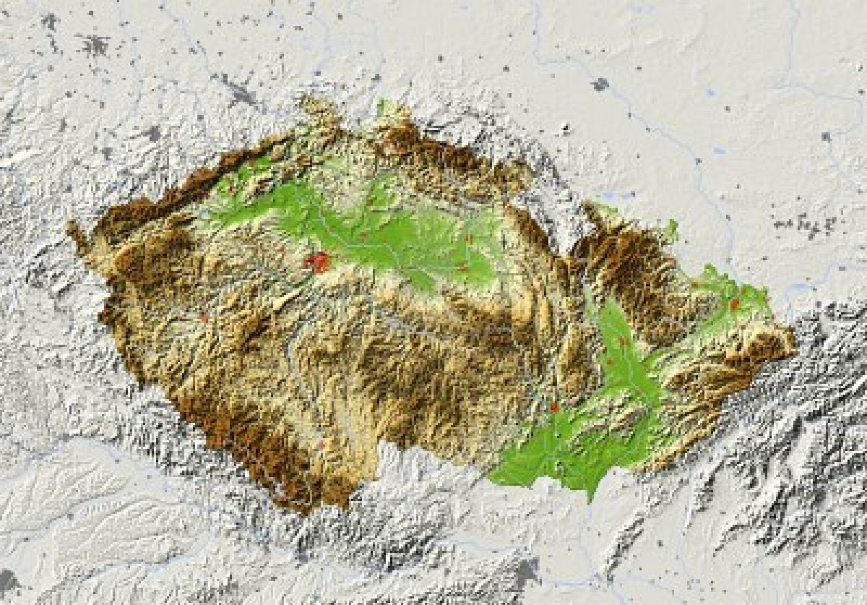
Relief

Slide 12
Relief
Bohemia in the west consists of rolling plains, hills, and plateaus surrounded by low mountains; Moravia in the east consists of very hilly country
lowest point: the Elbe River 115 m
highest point: Snezka 1,602 m
Among important mountain ranges we can mention the Giant Mountains (Krkonose), the Ash Mountains (Hruby Jesenik), the Carpathians, the Beskydy Mountains, and the Sumava Mountain range. The most important plains are along the Elbe river and in southern and central Moravia
The Czech Republic lies on the European watershed, which means the rivers are short and not suitable for transport. There are three drainage basins in the Czech Republic. They are the Elbe, the Morava and the Oder drainage basins

Slide 13
Zdroje
http://www.google.cz/imgres?um=1&hl=cs&sa=N&biw=1280&bih=656&tbm=isch&tbnid=5OP-UfZME_f-CM:&imgrefurl=http://realworldadventures.com/europe/Physical%2520Map%2520of%2520Czech.htm&docid=zYG5a6p2a5e0CM&imgurl=http://realworldadventures.com/europe/Physical%252520Map%252520of%252520Czech_files/czech-republic.jpg&w=750&h=454&ei=oWqRUK2mOIbdsgbcwYCIBw&zoom=1&iact=hc&vpx=542&vpy=116&dur=81&hovh=175&hovw=289&tx=114&ty=95&sig=104645909987912854339&page=3&tbnh=143&tbnw=262&start=37&ndsp=20&ved=1t:429,i:194
http://www.google.cz/imgres?um=1&hl=cs&qscrl=1&rlz=1T4ASUS_cs___CZ419&biw=1280&bih=656&tbm=isch&tbnid=5qMJ37bbt7zvGM:&imgrefurl=http://www.freeworldmaps.net/europe/index.html&docid=goROybqukXHmkM&imgurl=http://www.freeworldmaps.net/europe/europe-physical-map.jpg&w=750&h=678&ei=U3SRUKygMYXRtAbJmoAQ&zoom=1&iact=hc&vpx=179&vpy=346&dur=124&hovh=213&hovw=236&tx=114&ty=102&sig=104645909987912854339&page=3&tbnh=142&tbnw=157&start=37&ndsp=20&ved=1t:429,i:199
http://www.google.cz/imgres?um=1&hl=cs&sa=N&biw=1280&bih=656&tbm=isch&tbnid=5qMJ37bbt7zvGM:&imgrefurl=http://www.freeworldmaps.net/europe/index.html&docid=goROybqukXHmkM&imgurl=http://www.freeworldmaps.net/europe/europe-physical-map.jpg&w=750&h=678&ei=oWqRUK2mOIbdsgbcwYCIBw&zoom=1&iact=rc&dur=243&sig=104645909987912854339&page=3&tbnh=142&tbnw=157&start=37&ndsp=20&ved=1t:429,i:203&tx=89&ty=http://www.google.cz/imgres?imgurl=http://rysava.websnadno.cz/vlastiveda_5.roc/eu1.jpg&imgrefurl=http://rysava.websnadno.cz/vlastiveda_5.roc/evropska_unie.htm&h=368&w=369&sz=37&tbnid=8qFqI1V_xbMJTM:&tbnh=103&tbnw=103&zoom=1&usg=__VjofcJQb1asXz_seNLwphWhfn0I=&docid=CvvKTl4MsAsvsM&hl=cs&sa=X&ei=ZW6RUKOoBYzFtAbS3YD4Cw&ved=0CEsQ9QEwBg&dur=1
http://www.google.cz/imgres?um=1&hl=cs&sa=N&biw=1280&bih=656&tbm=isch&tbnid=h4k7FuDfqVT0FM:&imgrefurl=http://weonlywanttheearth.blogspot.com/2011/12/why-does-nato-still-exist.html&docid=wQ2GcUp15cTpzM&imgurl=http://4.bp.blogspot.com/-3D1pJVhRBzo/TxAXDgFmg1I/AAAAAAAAAQA/Xx7nmCof808/s1600/b_20100401134323Flag_of_NATO.gif&w=573&h=573&ei=2W2RUI7wPMXPtAbg2oDgCA&zoom=1&iact=hc&vpx=629&vpy=72&dur=1301&hovh=225&hovw=225&tx=114&ty=113&sig=104645909987912854339&page=1&tbnh=138&tbnw=138&start=0&ndsp=16&ved=1t:429,i:118
http://www.google.cz/imgres?um=1&hl=cs&sa=N&qscrl=1&rlz=1T4ASUS_cs___CZ419&biw=1280&bih=656&tbm=isch&tbnid=vMW9Ee4yg-FtBM:&imgrefurl=http://theintelhub.com/2010/09/27/the-united-nations-a-one-world-government/&docid=cQcLC0YX4jjfIM&imgurl=http://theintelhub.com/wp-content/uploads/2010/07/united-nations1.jpeg&w=550&h=506&ei=GXSRUJ_KIs3Osga29IDQAw&zoom=1&iact=rc&dur=187&sig=104645909987912854339&page=2&tbnh=147&tbnw=164&start=15&ndsp=21&ved=1t:429,i:117&tx=99&ty=70
http://www.google.cz/imgres?imgurl=http://us.123rf.com/400wm/400/400/mschmeling/mschmeling1110/mschmeling111000084/10768819-czech-republic-shaded-relief-map-with-major-urban-areas-surrounding-territory-greyed-out-colored-acc.jpg&imgrefurl=http://www.123rf.com/photo_10768819_czech-republic-shaded-relief-map-with-major-urban-areas-surrounding-territory-greyed-out-colored-acc.html&h=837&w=1200&sz=322&tbnid=-CRB8zTcxUNJSM:&tbnh=117&tbnw=168&zoom=1&usg=__LO_gRQBhYGudGydsIYIO-VUtYx4=&docid=j242XY4ExH3ySM&hl=cs&sa=X&ei=TIKRULXvFsb3sgbPk4HwAg&sqi=2&ved=0CEAQ9QEwBQ&dur=413

