Slide 1

Political system
Tematická oblast | Angličtina: The Czech Republic
Datum vytvoření | 19. 12. 2012
Ročník | 2. - 4., sexta – oktáva, úroveň B1
Stručný obsah | Úvod k tématu Česká republika, základní politické charakteristiky
Způsob využití | Otázky na základní informace o České republice. Ke každé otázce je vytvořena „vzorová odpověď“
Autor | Mgr. Jiřina Juříčková
Kód | VY_32_INOVACE_06_AJUR02
Gymnázium a Jazyková škola s právem státní jazykové zkoušky Zlín

Slide 2
Czech Republic
Political system

Slide 3
Political system
When speaking about this topic, you should be able to answer
the following questions:
What is the political system of the Czech Republic?
Who is the head of the state?
What is the capital of the country?
What are the main constitutional institutions?
What are the main symbols of the Czech Republic?
What are the territorial administrative units?

Slide 4
Political system
The Czech Republic is a parliamentary democracy with the president as
The head of the state. The capital city is Prague.
The president is elected for 5-year terms and can be elected for two terms
in a row. The president`s power is limited.
The Parliament consists of two chambers, the Chamber of Deputies
and the Senate. Deputies are elected for four-year terms and Senators
for six-year terms. The Parliament passes all bills valid in the Czech Republic
and it approves of important international treaties.

Slide 5
Political system
The Government of the Czech Republic consists of the Prime Minister,
Deputy Prime Minister and Ministers.
It is a supreme executive power of the country.
It manages state administration in the country`s territory.

Slide 6
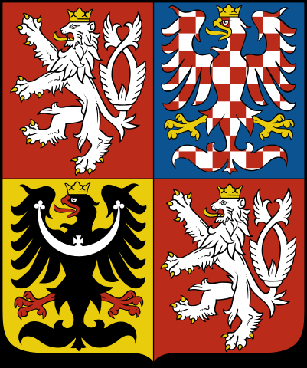
National Symbols
The Czech coat of arms dates back to the 1200's. It consists of a shield divided into 4 squares.
The top left and bottom right squares are red, with a 2-tailed, white, crowned lion. The lion is the symbol of Bohemia.
The top right square is blue and contains a red-and-white checkered, crowned eagle. This is the Moravian eagle.
The bottom left square is gold and contains a black, crowned eagle, which symbolizes the Silezian region of the country.
Today, the Czech lion by itself is also used as a symbol of the Czech Republic.

Slide 7
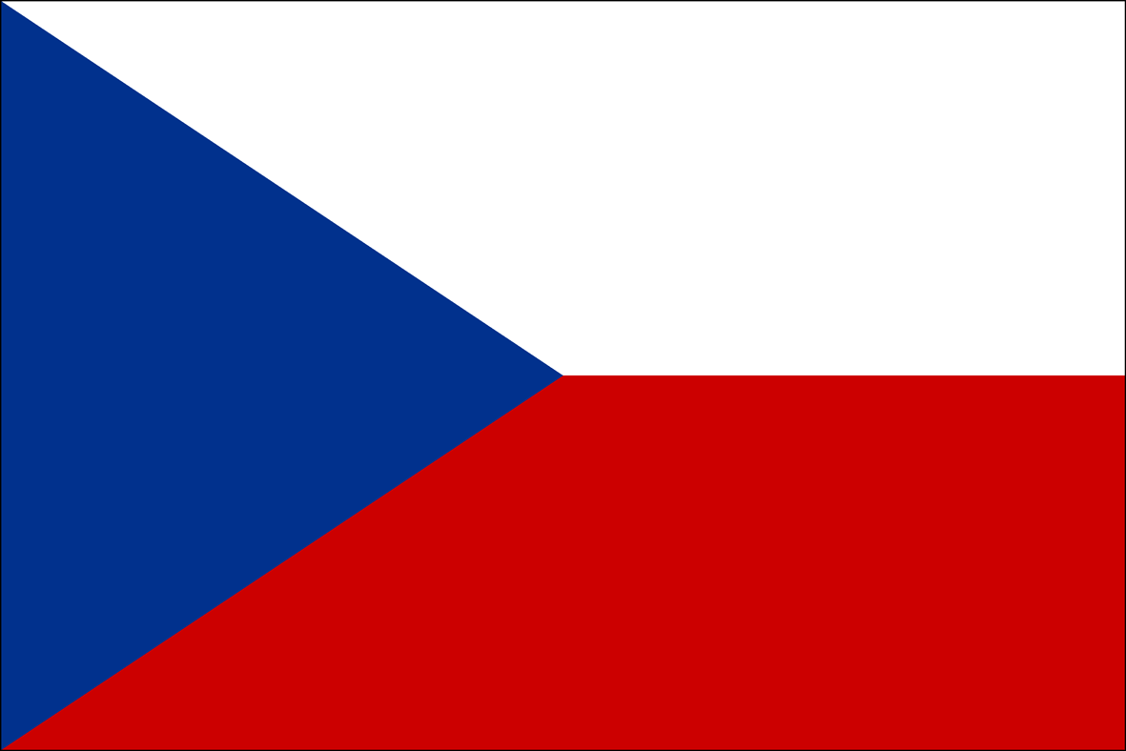
National Symbols
a white-red-and-blue flag in a simple geometric pattern, was created in 1920, shortly after the founding of the first independent Czechoslovak state.
the white, red, and blue colours are both symbolic and historic.
white (or silver) is the traditional colour of Bohemia and represents the sky. Moravia is symbolized by the colour red which also represents the blood shed for the freedom of the state. Blue is the traditional colour of Slovakia.

Slide 8
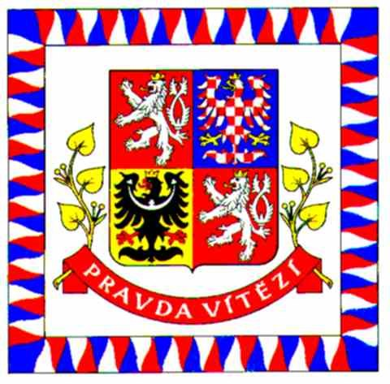
National Symbols
The banner of the president of the republic is white and its selvage consists of a number of alternating white, red and blue flame-shaped ornaments.
In the middle of the white field is the large state emblem below which is a white (silver) inscription saying "TRUTH WILL PREVAIL" on a red ribbon underlaid with yellow (golden) linden twigs on both sides.

Slide 9
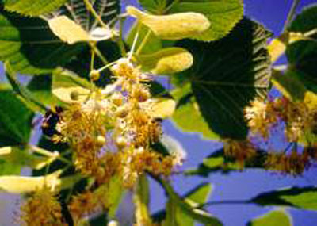
National Symbols
The state anthem is the first verse of the song "Where is my home" composed by František Škroup to the lyrics by Josef Kajetán Tyl.
Lime-tree is also considered to be one of the Czech national symbols

Slide 10
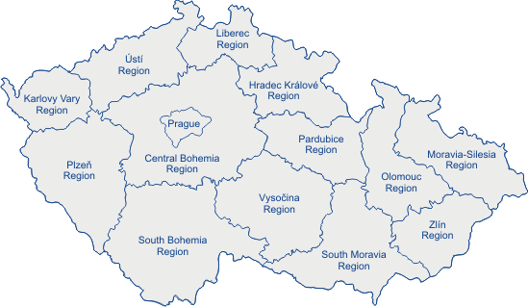
Territorial administrative units
The Czech Republic, is divided into fourteen territorial administration units, called regions. The regions are governed by Regional Authorities. Historically, there are three regions – Bohemia, Moravia, and Silesia.

Slide 11
Zdroje
http://www.google.cz/imgres?q=symbols+of+the+czech+republic&um=1&hl=cs&sa=N&biw=1280&bih=795&tbm=isch&tbnid=eB-dc5gvCpZ21M:&imgrefurl=http://en.wikipedia.org/wiki/File:Coat_of_arms_of_the_Czech_Republic.svg&docid=TUO_0cVDTBF6wM&imgurl=http://upload.wikimedia.org/wikipedia/commons/thumb/e/ed/Coat_of_arms_of_the_Czech_Republic.svg/401px-Coat_of_arms_of_the_Czech_Republic.svg.png&w=401&h=480&ei=QaebUKWnAYSn4gTJqIGgCg&zoom=1&iact=rc&dur=250&sig=113303616557843506100&page=2&tbnh=147&tbnw=123&start=25&ndsp=30&ved=1t:429,r:22,s:25,i:224&tx=51&ty=77
http://www.google.cz/imgres?imgurl=http://www.olstars.com/images/flags/Big/cz.gif&imgrefurl=http://www.olstars.com/en/flag/Czech%2BRepublic&h=788&w=1181&sz=10&tbnid=V0G104EvaaILHM:&tbnh=80&tbnw=120&prev=/search%3Fq%3Dflag%2Bof%2Bthe%2Bczech%2Brepublic%26tbm%3Disch%26tbo%3Du&zoom=1&q=flag+of+the+czech+republic&usg=__iBN4s7MUNqNunStLK0exbn-yWEA=&docid=HNuMP83PuV_ldM&sa=X&ei=RaibUMjXO-uL4gS-nIHoCQ&ved=0CCwQ9QEwAw&dur=5687
http://www.google.cz/imgres?q=symbols+of+the+czech+republic&um=1&hl=cs&sa=N&biw=1280&bih=795&tbm=isch&tbnid=7vzN-6pgkscaoM:&imgrefurl=http://www.czechgallery.com/flag/index.html&docid=CPnXgc-NYCZx0M&imgurl=http://www.czechgallery.com/flag/image/prezident_vlajka.jpg&w=480&h=473&ei=uqibUJz1NYjl4QS_xIC4BQ&zoom=1&iact=hc&vpx=760&vpy=138&dur=5891&hovh=223&hovw=226&tx=111&ty=148&sig=113303616557843506100&page=1&tbnh=145&tbnw=147&start=0&ndsp=25&ved=1t:429,r:4,s:0,i:83
http://www.google.cz/imgres?q=national+symbols+of+the+czech+republic&um=1&hl=cs&biw=1280&bih=795&tbm=isch&tbnid=pcwpYGOY7PICxM:&imgrefurl=http://www.radio.cz/en/section/letter/losing-our-czechness&docid=tWjhNB-rlLjeTM&imgurl=http://img.radio.cz/pictures/priroda/lipa.jpg&w=400&h=285&ei=9q6bUMKKFcaF4gSJ7YGYDQ&zoom=1&iact=rc&dur=0&sig=113303616557843506100&page=1&tbnh=144&tbnw=190&start=0&ndsp=26&ved=1t:429,r:2,s:0,i:74&tx=100&ty=65
http://www.google.cz/imgres?imgurl=http://www.eu2009.cz/images/design/map-cz-en.gif&imgrefurl=http://www.eu2009.cz/en/czech-republic/regions/regions-of-the-czech-republic-329/index.html&h=319&w=549&sz=26&tbnid=LndIk7wO3QMG6M:&tbnh=70&tbnw=120&prev=/search%3Fq%3Dregions%2Bof%2Bthe%2Bczech%2Brepublic%26tbm%3Disch%26tbo%3Du&zoom=1&q=regions+of+the+czech+republic&usg=__C-VmZ_Dy54PDu9Y9NlCNGGsFi8U=&docid=rKVg5IGGLbNhdM&sa=X&ei=kLCbUOemNOfV4gTGroDIAw&ved=0CEIQ9QEwBQ&dur=844

