Slide 1

Meals
Tematická oblast | Angličtina: The Czech Republic
Datum vytvoření | 27. 11. 2012
Ročník | 2. - 4., sexta – oktáva, úroveň B1
Stručný obsah | Tradiční česká kuchyně, zvyky a návyky
Způsob využití | Otázky k české kuchyni, stravovacím návykům. Ke každé otázce je vytvořena „vzorová odpověď“
Autor | Mgr. Jiřina Juříčková
Kód | VY_32_INOVACE_06_AJUR03
Gymnázium a Jazyková škola s právem státní jazykové zkoušky Zlín

Slide 2
Czech Republic
Meals and Eating Habits

Slide 3
Czech meals and eating habits
What is traditional Czech cuisine like?
What are the traditional Czech meals?
What are the typical eating habits of the Czechs?
What is traditionally prepared for Christmas dinner?

Slide 4
Czech cuisine
Choose from the following adjectives and describe traditional Czech cuisine.
Healthy Fat Juicy Light
Tasty Rich Plain Crunchy
Colorful Boring Interesting Innovative
Full of vitamins With a lot of meat
Combines cereals and seeds Uses herbs . . . . .
Our traditional cuisine is . . . .
It is said that our traditional cuisine is . . . .
What I like/do not like about our traditional cuisine is . . . .
I think our traditional cuisine is . . . .

Slide 5
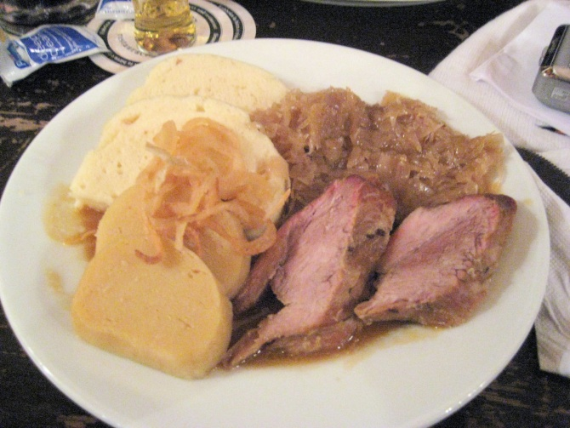
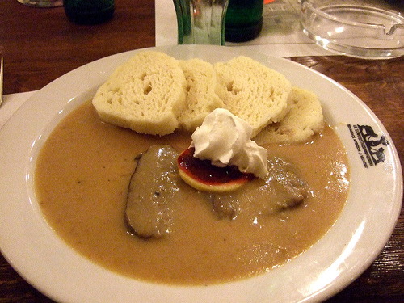
Traditional meals
What are the typical/traditional Czech meals? For what occasions they are usually prepared? What is special about them?

Slide 6
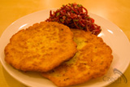
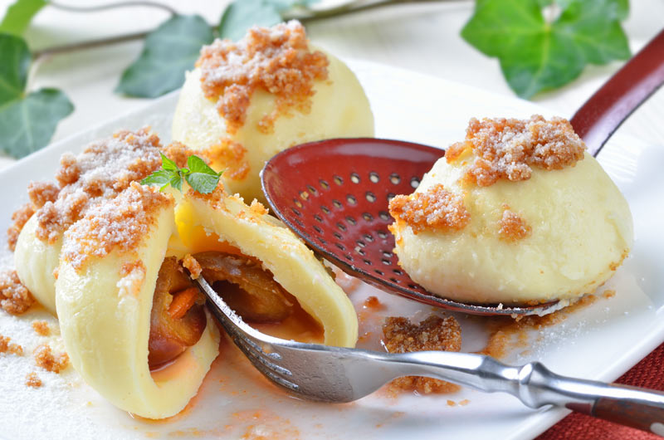
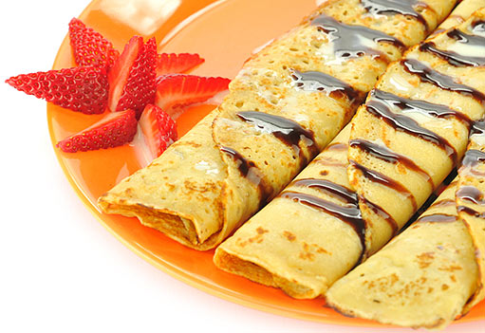
Traditional meals

Slide 7
Eating habits
How many meals a day do the Czechs have?
Which meal is the main meal of the day?
What do people usually have for breakfast/lunch/dinner?
Do people eat out often?
Have eating habits of Czech people changed in any way?

Slide 8
Eating habits
Czech people have from three to five meals a day. The main meal is lunch, which is often something warm / some meat with vegetables or rice or pasta
Some people have only breakfast, lunch, and dinner, some people have also snacks between main meals. As snacks people usually have some fruit or vegetables, yoghurt or something sweet.

Slide 9
Eating habits
Breakfasts and dinners are often cold – a slice of bread or a roll with ham or cheese. For breakfasts cereals with milk or yoghurt are also popular.
Eating habits of Czech people have changed – they eat less fatty meat, they have started eating more vegetables, chicken meat and fish. Italian and French food have become popular as well.

Slide 10
Eating out
Where can we eat out? What are typical features and main differences?
A restaurant a café a pub fast food restaurant
Wide variety of meals, soups, deserts
Soft and alcoholic drinks
Simple cold meals, snacks
Cakes, sweets
Coffee, soft and alcoholic drinks
Burgers, hot dogs, salad,

Slide 11
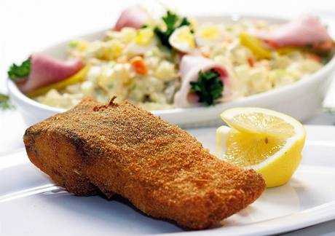
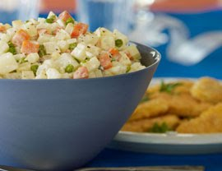
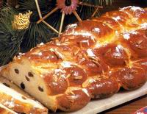
Christmas
The traditional Christmas dinner consists of . . . . People also prepare . . . .

Slide 12
Zdroje
http://www.google.cz/imgres?q=traditional+czech+food&hl=cs&sa=X&tbo=d&biw=1024&bih=685&tbm=isch&tbnid=BHlnjPPZtJwlsM:&imgrefurl=http://thejetpacker.com/u-fleku-pragues-most-popular-beer-hall/traditional-czech-food-at-u-fleku/&docid=2h7ls7H2oFsvAM&imgurl=http://thejetpacker.com/wp-content/uploads/2009/07/Traditional-Czech-Food-At-U-Fleku.jpg&w=1280&h=960&ei=Lqq0UO6sI43mtQaH1YBY&zoom=1&iact=hc&vpx=2&vpy=299&dur=6965&hovh=194&hovw=259&tx=121&ty=85&sig=117809575946673020716&page=1&tbnh=136&tbnw=174&start=0&ndsp=20&ved=1t:429,r:5,s:0,i:100
http://www.google.cz/imgres?q=traditional+czech+food&hl=cs&sa=X&tbo=d&biw=1024&bih=685&tbm=isch&tbnid=eHnf1jIsxcBRQM:&imgrefurl=http://mydeliciousfoods.blogspot.com/2010/06/traditional-czech-foods.html&docid=bqyaIvPNmzydfM&imgurl=http://farm2.static.flickr.com/1190/1009702693_2211df9356.jpg&w=500&h=375&ei=Lqq0UO6sI43mtQaH1YBY&zoom=1&iact=hc&vpx=2&vpy=378&dur=3364&hovh=194&hovw=259&tx=95&ty=112&sig=117809575946673020716&page=1&tbnh=137&tbnw=174&start=0&ndsp=20&ved=1t:429,r:10,s:0,i:115
http://www.google.cz/imgres?q=traditional+czech+food&um=1&hl=cs&sa=N&tbo=d&biw=1024&bih=685&tbm=isch&tbnid=gdvQBTFyZi4HgM:&imgrefurl=http://www.prague.fm/eating/&docid=0qaVGPpFXXzhhM&imgurl=http://cdn.prague.fm/wp-content/gallery/czech-food/czech_food2.jpg&w=800&h=530&ei=Aqu0UNTfFZDMsgaZ2IAY&zoom=1&iact=hc&vpx=606&vpy=306&dur=711&hovh=183&hovw=276&tx=115&ty=96&sig=117809575946673020716&page=1&tbnh=148&tbnw=237&start=0&ndsp=20&ved=1t:429,r:18,s:0,i:139
http://www.google.cz/imgres?q=traditional+czech+food&um=1&hl=cs&sa=N&tbo=d&biw=1024&bih=685&tbm=isch&tbnid=ZSkzfmc1PN0MvM:&imgrefurl=http://czechunderscope.com/culture/czech-cuisine/czech-recipes/lng/en/&docid=0xuFXG8Tv6WH8M&imgurl=http://czechunderscope.com/wp-content/uploads/2009/11/bramborak7.jpg&w=160&h=107&ei=Aqu0UNTfFZDMsgaZ2IAY&zoom=1&iact=hc&vpx=464&vpy=238&dur=1287&hovh=85&hovw=128&tx=83&ty=54&sig=117809575946673020716&page=2&tbnh=85&tbnw=117&start=20&ndsp=26&ved=1t:429,r:43,s:0,i:218
http://www.google.cz/imgres?q=pancakes&um=1&hl=cs&tbo=d&biw=1024&bih=685&tbm=isch&tbnid=Ycq43_Ef4X7IdM:&imgrefurl=http://www.ireceptar.cz/vareni-a-recepty/dorty-kolace-cukrovi/palacinky-mnohokrat-jinak-pet-zajimavych-receptu/&docid=hJoM2t7XfrIpJM&imgurl=http://www.ireceptar.cz/res/data/093/011483.jpg&w=511&h=351&ei=x6u0UNeuAobEtAb9-YHoBw&zoom=1&iact=hc&vpx=391&vpy=118&dur=3202&hovh=186&hovw=271&tx=166&ty=108&sig=117809575946673020716&page=1&tbnh=138&tbnw=201&start=0&ndsp=20&ved=1t:429,r:7,s:0,i:103
tbnh=142&tbnw=212&start=0&ndsp=20&ved=1t:429,r:5,s:0,i:97
http://www.google.cz/imgres?q=czech+christmas+dinner&hl=cs&tbo=d&biw=1024&bih=685&tbm=isch&tbnid=lFCbEg6fbDls5M:&imgrefurl=http://czechvegan.blogspot.com/2010/11/my-first-published-recipe.html&docid=UIwsWTt0mkfc5M&imgurl=http://2.bp.blogspot.com/_w2GbB1rJV0U/TNAwM_R4reI/AAAAAAAAAGw/lQp0go7FS2M/s400/chicknfilletpotatosalad_MED.jpg&w=270&h=208&ei=jLi0UM_wD8SgtAae4YDwCg&zoom=1&iact=hc&vpx=443&vpy=322&dur=1213&hovh=166&hovw=216&tx=77&ty=69&sig=117809575946673020716&page=1&tbnh=142&tbnw=193&start=0&ndsp=20&ved=1t:429,r:7,s:0,i:103
http://www.google.cz/imgres?q=czech+christmas+dinner&hl=cs&tbo=d&biw=1024&bih=685&tbm=isch&tbnid=jTo4jh_xLeWGoM:&imgrefurl=http://www.makingthishome.com/2008/12/29/a-traditional-czech-christmas/&docid=6-wz3vSAVgp7uM&imgurl=http://www.makingthishome.com/wp-content/uploads/2008/12/vanocka.jpg&w=200&h=155&ei=jLi0UM_wD8SgtAae4YDwCg&zoom=1&iact=hc&vpx=821&vpy=187&dur=50&hovh=124&hovw=160&tx=83&ty=78&sig=117809575946673020716&page=1&tbnh=124&tbnw=160&start=0&ndsp=20&ved=1t:429,r:4,s:0,i:94

