Slide 1

Holidays
Tematická oblast | Angličtina: The Czech Republic
Datum vytvoření | 19. 12. 2012
Ročník | 2. - 4., sexta – oktáva, úroveň B1
Stručný obsah | Státní svátky a populární svátky v České Republice, zvyky a tradice
Způsob využití | Otázky k tradičním svátkům a zvykům, které jsou s nimi spojeny. Ke každé otázce je vytvořena „vzorová odpověď“
Autor | Mgr. Jiřina Juříčková
Kód | VY_32_INOVACE_06_AJUR04
Gymnázium a Jazyková škola s právem státní jazykové zkoušky Zlín

Slide 2
Czech Republic
Holidays and traditions

Slide 3
Holidays and traditions
Do the Czechs like celebrating holidays?
Do they follow traditions?
How many bank holidays are there in the CR?
What are the most popular holidays in the CR?

Slide 4
Bank holidays in the CR
There are twelve bank holidays in the Czech Republic.
Except for Easter Monday, the dates of the holidays are fixed.
The bank holidays are:
1 January - New Year's Day
Easter Monday
1 May - May Day
8 May - Liberation from Fascism
5 July - Cyril and Methodius
6 July - Burning at Stake of Jan Hus
28 September - Czech Statehood Day
28 October - Establishment of the Czechoslovak Republic
17 November - Freedom and Democracy Day
24 December - Christmas Eve
25 December - Christmas Day
26 December - Christmas Day

Slide 5
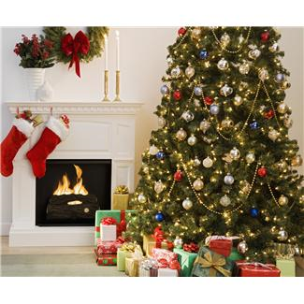
Christmas
Christmas Eve is celebrated on 24 December and is associated with many superstitions that usually relate to life, love, and destiny that awaits one in the year to come; e. g. one is supposed to fast all day to see the "golden piglet" in the evening
Dinner is served after sunset (traditionally, it should not be served until after the first star has come out) and consists of fried carp and potato salad
A traditional Christmas bread is called vánočka and is similar to the Jewish challa

Slide 6
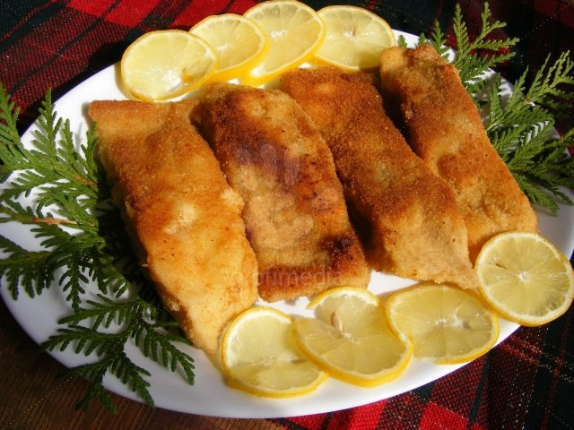
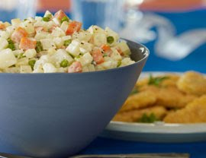
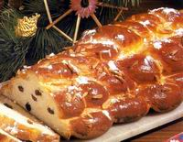
Christmas
The traditional Christmas dinner consists of . . . People also prepare . .

Slide 7
Christmas presents
Presents are placed under the Christmas tree.
Czech children believe that Christmas gifts are brought
by Baby Jesus.
Baby Jesus receives wish-list letters from Czech children a few weeks before Christmas.
Some people end Christmas Eve by attending the midnight mass at a local church. It usually starts at midnight but some churches hold it earlier

Slide 8
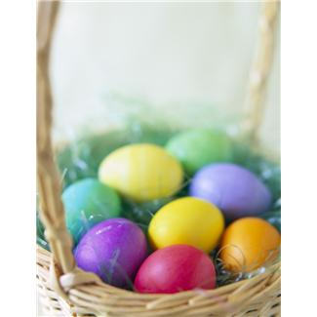
Easter
Many traditions are still observed and practised, especially in villages, and different regions may have their own Easter traditions and customs
Many Czech Easter symbols are related to spring and the beginning of new life. Some of the best known are:
hand-painted or otherwise decorated eggs
a braided whip made from pussy-willow twigs (thought to bring health and youth to anyone who is whipped with them)
red and other bright colors symbolize health, joy, happiness and new life that comes with the spring

Slide 9
All Souls Day
All Souls’ Day falls on November 2nd
It is a quiet time in the Czech Republic. People visit the graves of family members and relatives to light candles, lay flowers and wreaths and spend a few moments

Slide 10
Saint Nicholas Day
Is celebrated on the eve of St. Nicholas Day, December 5th.
Three (St. Nicholas, the Angel and the Devil) characters come to homes, asking children if they were good in the past year. Most kids say yes and sing a song or recite a short poem. They are then rewarded with sweets, candy or other treats, which are handed out by the Angel.
Bad kids would be put in the Devil's sack and taken to hell, or would only get a sack of potatoes or coal instead of candy

Slide 11
Other holidays
The Czechs don`t celebrate other holidays very much.
Among traditional holidays we can mention the Burning of the Witches, May 1, and St. Joseph`s Day.
More and more people celebrate holidays “imported” from the English speaking countries such as St. Valentine`s Day or Halloween
New Year`s Eve
is another popular celebration during which people hold or are invited to parties and celebrate the new year`s coming
quite a lot of people gather together in the streets, celebrate there and watch firework displays at midnight

Slide 12
Zdroje
http://office.microsoft.com/cs-cz/images/results.aspx?qu=christmas&ex=2#ai:MP900431277|
http://www.google.cz/imgres?q=traditional+czech+christmas+dinner&hl=cs&tbo=d&biw=1280&bih=795&tbm=isch&tbnid=jTo4jh_xLeWGoM:&imgrefurl=http://www.makingthishome.com/2008/12/29/a-traditional-czech-christmas/&docid=6-wz3vSAVgp7uM&imgurl=http://www.makingthishome.com/wp-content/uploads/2008/12/vanocka.jpg&w=200&h=155&ei=scrSUMW-BcvFtAaZ_oCQAw&zoom=1&iact=rc&dur=203&sig=111004449778356183307&page=1&tbnh=124&tbnw=153&start=0&ndsp=27&ved=1t:429,r:2,s:0,i:91&tx=75&ty=74
http://www.google.cz/imgres?q=traditional+czech+fried+carp&hl=cs&tbo=d&biw=1280&bih=795&tbm=isch&tbnid=lFCbEg6fbDls5M:&imgrefurl=http://czechvegan.blogspot.com/2010/11/my-first-published-recipe.html&docid=UIwsWTt0mkfc5M&imgurl=http://2.bp.blogspot.com/_w2GbB1rJV0U/TNAwM_R4reI/AAAAAAAAAGw/lQp0go7FS2M/s400/chicknfilletpotatosalad_MED.jpg&w=270&h=208&ei=DcvSUKz-E87QsgbQ5oCABA&zoom=1&iact=hc&vpx=2&vpy=358&dur=579&hovh=166&hovw=216&tx=84&ty=82&sig=111004449778356183307&page=2&tbnh=149&tbnw=187&start=25&ndsp=35&ved=1t:429,r:25,s:0,i:165
http://www.google.cz/imgres?q=traditional+czech+fried+carp&hl=cs&tbo=d&biw=1280&bih=795&tbm=isch&tbnid=OHGhVkipKJ34EM:&imgrefurl=http://www.profimedia.si/picture/czech-traditional-christmas-meal-fried-carp/0012839222/&docid=IHxdvbCP3BcQWM&imgurl=http://www.profimedia.si/photo/czech-traditional-christmas-meal-fried-carp/profimedia-0012839222.jpg&w=640&h=480&ei=DcvSUKz-E87QsgbQ5oCABA&zoom=1&iact=hc&vpx=176&vpy=277&dur=5672&hovh=194&hovw=259&tx=135&ty=84&sig=111004449778356183307&page=1&tbnh=137&tbnw=191&start=0&ndsp=25&ved=1t:429,r:7,s:0,i:106
http://office.microsoft.com/cs-cz/images/results.aspx?qu=easter&ex=1#ai:MP900422835|

