Slide 1

History
Tematická oblast | Angličtina: The Czech Republic
Datum vytvoření | 21. 12. 2012
Ročník | 2. - 4., sexta – oktáva, úroveň B1
Stručný obsah | Stručný historický přehled
Způsob využití | Otázky na základní historická fakta a osobnosti. Forma otázek, zajímavostí a cvičení
Autor | Mgr. Jiřina Juříčková
Kód | VY_32_INOVACE_06_AJUR05
Gymnázium a Jazyková škola s právem státní jazykové zkoušky Zlín

Slide 2
Czech Republic
History

Slide 3
Did you know?
Did you know that:
The meaning of “great” in the name Great Moravia was “far away” – according to the Byzantines?
The largest area in the history of our country was under the rule of Otakar II in 13th century?
Our country had the greatest political and cultural influence under the rule of Charles IV in 14th century?
After the breakup of the Austrian-Hungarian empire it became independent and was divided into 4 historical countries?
The main part of the country`s border belongs to the oldest and most stable within European continent (some parts are more than 900 years old)?

Slide 4
Historical timeline
Put the following periods and personalities into the right order according to the time:
King Otakar II Great Moravian Empire Samo`s Empire
The Habsburg Empire Charles IV Master Jan Hus
Renewal of the independent state The overthrow of the Communist regime
The Communist takeover The Premyslid dynasty Prague Spring
Foundation of the Czech Republic

Slide 5
Historical timeline
Samo`s Empire
Great Moravia
The Premyslid dynasty
King Otakar II
Charles IV
Master Jan Hus
The Habsburg Empire
Renewal of the independent state
The Communist takeover
Prague Spring
The overthrow of the Communist regime
Foundation of the Czech Republic

Slide 6
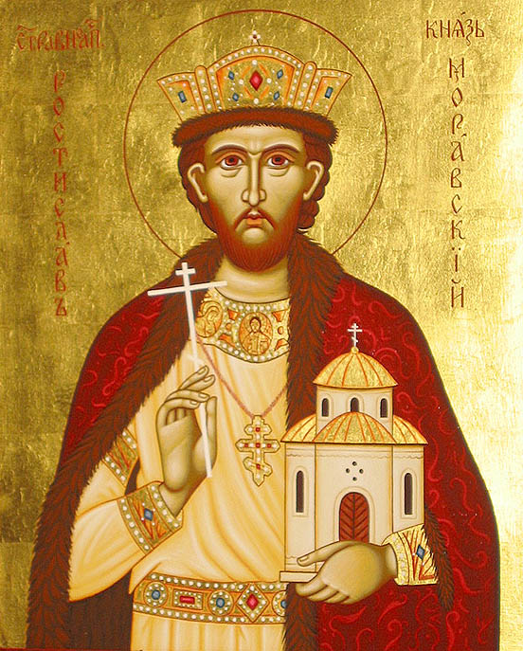
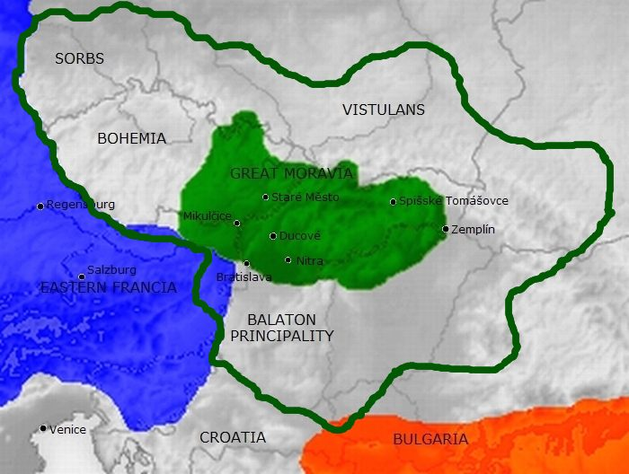
Who is Who
Do you know these personalities of the Czech history? What do you know about them?
?

Slide 7
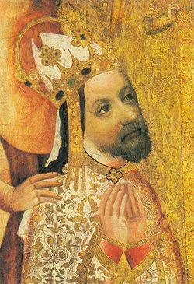
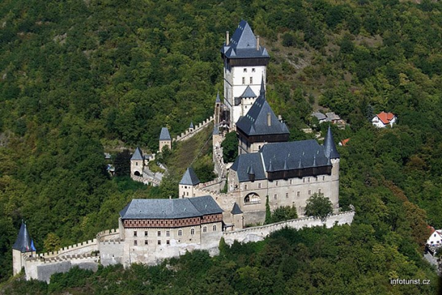
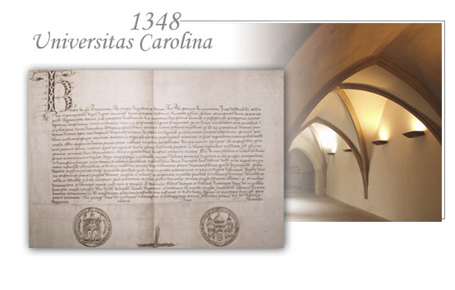
Who is Who
?

Slide 8
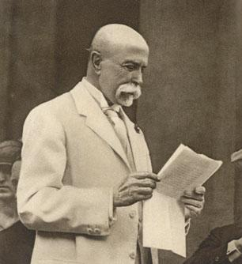
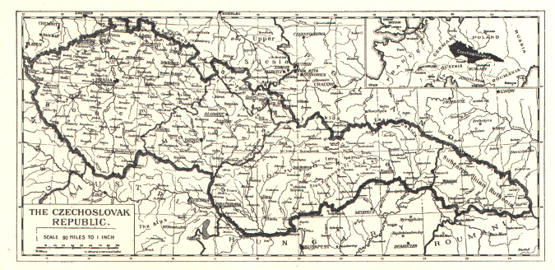
Who is Who
?

Slide 9
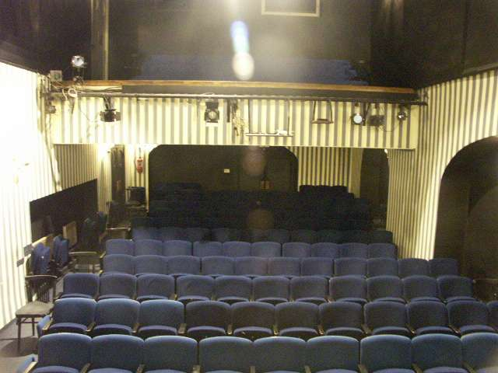
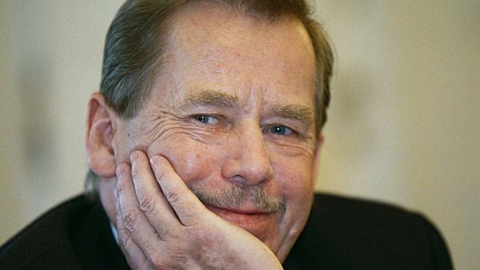
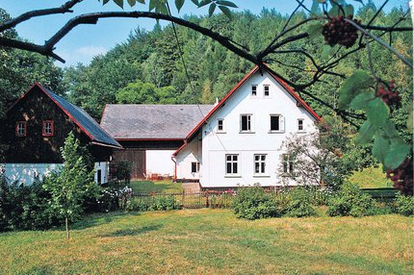
Who is Who

Slide 10
Who is Who
1) Frankish merchant Samo first united Slavonic tribes into the so-called Samo`s Kingdom in the 7th century
2) The Czech King Charles IV of the Luxemburg dynasty
    a) in 1344 he founded the Prague Archbishopric
    b) he established Charles University in 1348 - it was the first university founded north of the Alps
    c) Charles IV was crowned Roman Emperor in Rome in 1355

Slide 11
Who is Who
3) Tomas Garrigue Masaryk – a Czech statesman, who together with E. Benes supported the foundation of the independent Czechoslovak Republic; he became the first president of Czechoslovakia
4) Vaclav Havel was a leading figure of the Velvet Revolution of 1989; then he became president and was also the first president of the independent Czech Republic

Slide 12
Zdroje
http://www.google.cz/imgres?q=Slavic+leader+Mojmir&um=1&hl=cs&tbo=d&biw=1280&bih=795&tbm=isch&tbnid=ydXdbzReZrRHUM:&imgrefurl=http://molonlabe70.blogspot.com/2010_05_01_archive.html&docid=MlAV-k2ptRzeHM&imgurl=http://2.bp.blogspot.com/_jPc5hebaTs8/S-jScQeCYdI/AAAAAAAAGSA/HQ1net5mcoY/s1600/0511rostislavmoravia.jpg&w=552&h=687&ei=3CzUUNzrMMfAtAbjg4CYCg&zoom=1&iact=rc&dur=125&sig=111004449778356183307&page=1&tbnh=141&tbnw=104&start=0&ndsp=28&ved=1t:429,r:26,s:0,i:168&tx=51&ty=50http://www.google.cz/imgres?q=frankish+merchant+samo&um=1&hl=cs&sa=N&tbo=d&biw=1280&bih=795&tbm=isch&tbnid=s8GremOXwcC77M:&imgrefurl=
http://www.your-apartments.com/czech-republic-great-moravian-empire.html&docid=B80vgq3SNYaxGM&imgurl=http://www.your-apartments.com/content/cms/en/czech-republic/travel-guide-czech-republic/history-of-czech-republic/great-moravian-empire/Great-Moravia-map-01-1.jpg&w=700&h=528&ei=5irUUKHSBoXRtAaBvoGACA&zoom=1&iact=hc&vpx=2&vpy=127&dur=1125&hovh=195&hovw=259&tx=122&ty=97&sig=111004449778356183307&page=1&tbnh=144&tbnw=198&start=0&ndsp=39&ved=1t:429,r:0,s:0,i:88
http://www.google.cz/imgres?q=Charles+IV&um=1&hl=cs&tbo=d&biw=1280&bih=795&tbm=isch&tbnid=BuZ0gWyfxpHZaM:&imgrefurl=http://cs.wikipedia.org/wiki/Karel_IV.&docid=zNbhyEjgD4trdM&imgurl=http://upload.wikimedia.org/wikipedia/commons/thumb/1/16/Charles_IV-John_Ocko_votive_picture-fragment.jpg/250px-Charles_IV-John_Ocko_votive_picture-fragment.jpg&w=250&h=365&ei=ey3UULatJIrUsgbZtIHwBA&zoom=1&iact=rc&dur=219&sig=111004449778356183307&page=1&tbnh=148&tbnw=107&start=0&ndsp=38&ved=1t:429,r:1,s:0,i:102&tx=54&ty=81
http://www.google.cz/imgres?q=Karlstejn&um=1&hl=cs&tbo=d&biw=1280&bih=795&tbm=isch&tbnid=3m5usIq4t06MKM:&imgrefurl=http://www.hradyazamky24.cz/hrad-karlstejn-21&docid=F9ZPpWUOjluyJM&imgurl=http://www.hradyazamky24.cz/wp-content/gallery/hrad-karlstejn/karlstejn_6_vw-04.jpg&w=720&h=480&ei=Iy7UUPzWEMzcsgaY44DYCA&zoom=1&iact=hc&vpx=2&vpy=434&dur=6125&hovh=183&hovw=275&tx=108&ty=154&sig=111004449778356183307&page=1&tbnh=138&tbnw=204&start=0&ndsp=24&ved=1t:429,r:12,s:0,i:121
http://www.google.cz/imgres?q=charles+university&um=1&hl=cs&tbo=d&biw=1280&bih=795&tbm=isch&tbnid=pTyoFuppZaOD4M:&imgrefurl=http://www.cuni.cz/UKENG-1.html&docid=83oM1BvaQdKkpM&imgurl=http://www.cuni.cz/uk/images_layout/uvod_gfx/aktual_listina2.jpg&w=554&h=353&ei=BzDUUPj4C43htQads4DYBw&zoom=1&iact=hc&vpx=953&vpy=171&dur=531&hovh=179&hovw=281&tx=167&ty=89&sig=111004449778356183307&page=1&tbnh=144&tbnw=220&start=0&ndsp=24&ved=1t:429,r:5,s:0,i:114
http://www.google.cz/imgres?q=T.G.Masaryk&um=1&hl=cs&tbo=d&biw=1280&bih=795&tbm=isch&tbnid=KzNnmBDmGFhFFM:&imgrefurl=http://krajane.radio.cz/articleDetail.view%3Fid%3D1315&docid=P7ZVvqygAE3H5M&imgurl=http://img.radio.cz/pictures/krajani-web/masaryk1__16.jpg&w=306&h=334&ei=6TDUUPO3NoKDtAbF8oHIBg&zoom=1&iact=hc&vpx=2&vpy=311&dur=3953&hovh=235&hovw=215&tx=108&ty=109&sig=111004449778356183307&page=1&tbnh=138&tbnw=127&start=0&ndsp=36&ved=1t:429,r:9,s:0,i:114
http://www.google.cz/imgres?q=czechoslovakia+1918&um=1&hl=cs&tbo=d&biw=1280&bih=795&tbm=isch&tbnid=2Sdv6IW-5TLXQM:&imgrefurl=http://www.expats.cz/prague/article/czech-culture/split-of-czechoslovakia/&docid=lBt1aHE5e6Tq7M&imgurl=http://www.expats.cz/content_files/438/czechoslovakia1918_1.png&w=675&h=328&ei=njHUUO6UEI3AtAazy4DQBQ&zoom=1&iact=rc&dur=312&sig=111004449778356183307&page=1&tbnh=130&tbnw=260&start=0&ndsp=26&ved=1t:429,r:4,s:0,i:97&tx=152&ty=69
http://www.google.cz/imgres?q=v%C3%A1clav+havel&um=1&hl=cs&tbo=d&biw=1280&bih=795&tbm=isch&tbnid=jfDmQlITgSa5hM:&imgrefurl=http://tema.novinky.cz/vaclav-havel&docid=NgyvlDGZ1QJ8AM&imgurl=http://im.novinky.cz/170/201708-top_foto1-91f0j.jpg&w=600&h=338&ei=VDLUUOWtJ4rftAaDnoDoBA&zoom=1&iact=hc&vpx=935&vpy=431&dur=4750&hovh=168&hovw=299&tx=122&ty=78&sig=111004449778356183307&page=2&tbnh=135&tbnw=232&start=29&ndsp=33&ved=1t:429,r:35,s:0,i:195
http://www.ahaonline.cz/clanek/musite-vedet/67493/havluv-hradecek-tady-planoval-sametovou-revoluci-a-nakonec-tu-i-zemrel.html
http://www.google.cz/imgres?q=divadlo+na+z%C3%A1bradl%C3%AD&um=1&hl=cs&tbo=d&biw=1280&bih=795&tbm=isch&tbnid=XdT0kqxTPGU4cM:&imgrefurl=http://old.nazabradli.cz/podporte-nas/pronajem-prostor/pruhovany-sal/&docid=xYjIIPqX1zchCM&imgurl=http://old.nazabradli.cz/picture/obrazky/sal.JPG&w=640&h=480&ei=ezPUUImcJIXasgbC_4GoBA&zoom=1&iact=hc&vpx=366&vpy=161&dur=6875&hovh=194&hovw=259&tx=138&ty=93&sig=111004449778356183307&page=1&tbnh=139&tbnw=179&start=0&ndsp=24&ved=1t:429,r:2,s:0,i:105

