Slide 1

Tourism
Tematická oblast | Angličtina: The Czech Republic
Datum vytvoření | 27. 12. 2012
Ročník | 2. - 4., sexta – oktáva, úroveň B1
Stručný obsah | Stručný geografický přehled zajímavých turistických oblastí/míst
Způsob využití | Otázky na nejznámější turistické oblasti/místa. Forma otázek a cvičení
Autor | Mgr. Jiřina Juříčková
Kód | VY_32_INOVACE_06_AJUR06
Gymnázium a Jazyková škola s právem státní jazykové zkoušky Zlín

Slide 2
Czech Republic
Tourism

Slide 3
Can you?
Describe the geography of the Czech Republic?
Name the most well-known spa towns?
Name some of the well-known historical towns?
Name some well-known castles?
Name some interesting areas of natural beauty?

Slide 4
Geography of the Czech Republic
The Czech Republic lies in the temperate climatic zone which is characterised by four distinct seasons.
The landscape of the country is mountainous along the borders, hilly in the centre and flat along bigger rivers. All the mountains are quite heavily forested.
There are also a lot of ponds in the Czech Republic, mainly in Southern Bohemia, and a lot of mineral and hot springs.

Slide 5
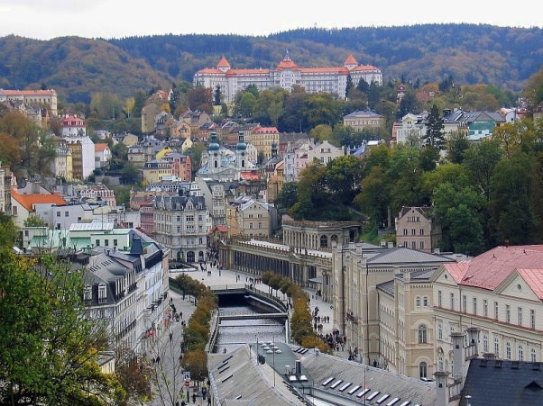
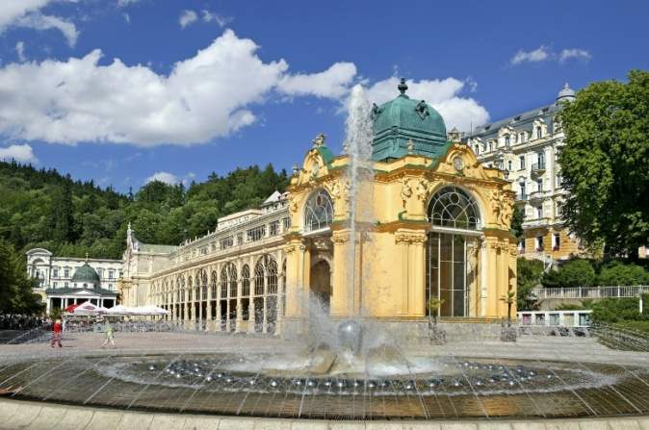
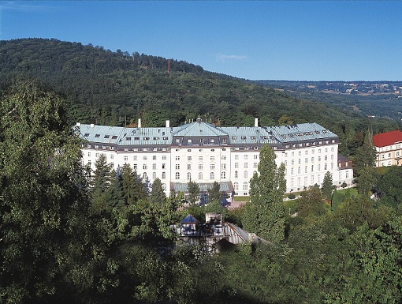
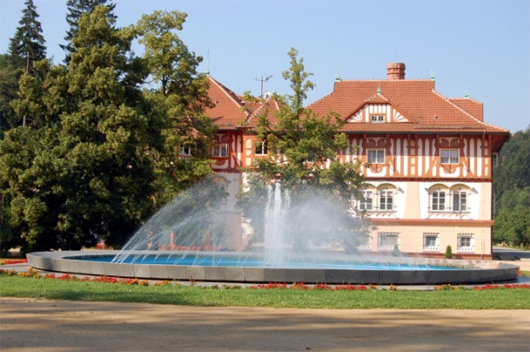
Spa towns
Match the names with the places:
Jáchymov
Karlovy Vary
Mariánské lázně
Luhačovice

Slide 6
Spa towns
Karlovy Vary
Mariánské Lázně
Jáchymov
Do you know any other spa towns?
Do you know more about the places in the photos?
Luhačovice

Slide 7
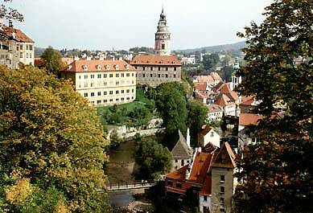
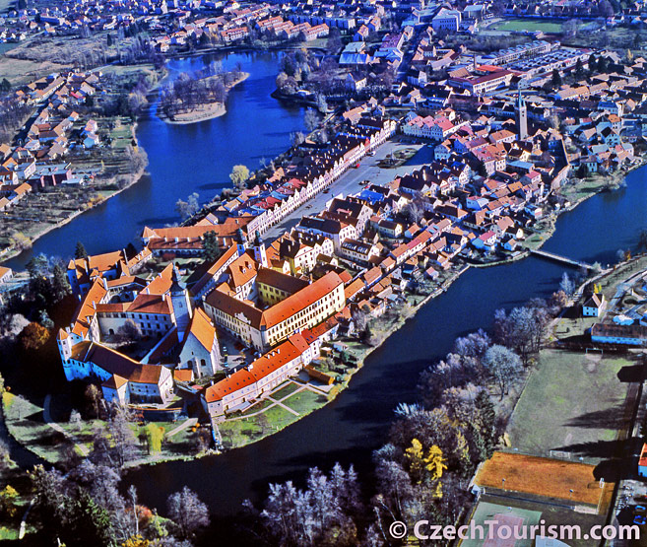
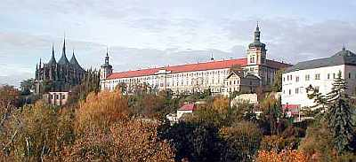
Historical Towns
Match the towns with the names
Kutná Hora
Český Krumlov
Telč

Slide 8
Historical Towns
Telč
Český Krumlov
Kutná Hora
Do you know more about these towns?
Do you know any other historical towns?

Slide 9
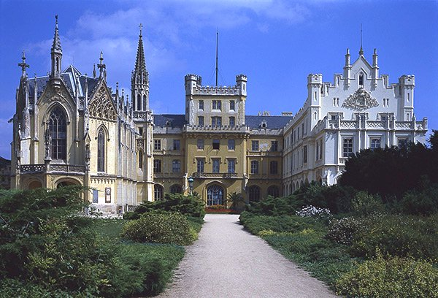
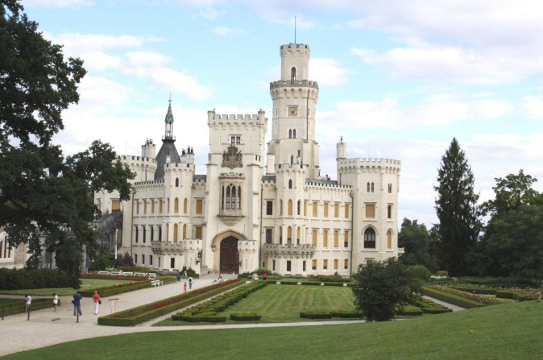
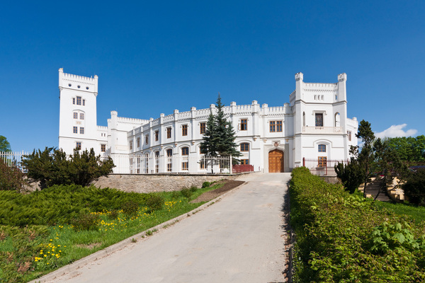
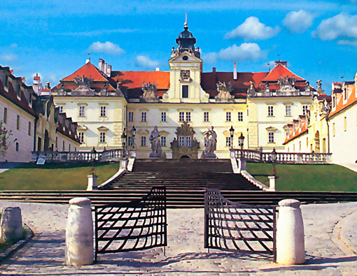
Well-known castles
Do you know these places? Is any of these castles in your region?

Slide 10
Well-known castles
Lednice
Hluboká
Valtice
Světlov, in our region
Which castles would you suggest visiting?
Why?

Slide 11
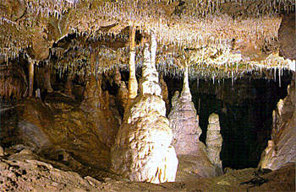
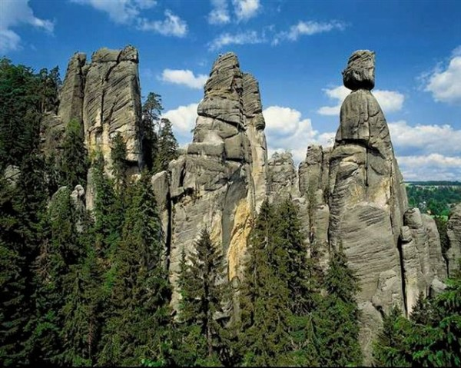
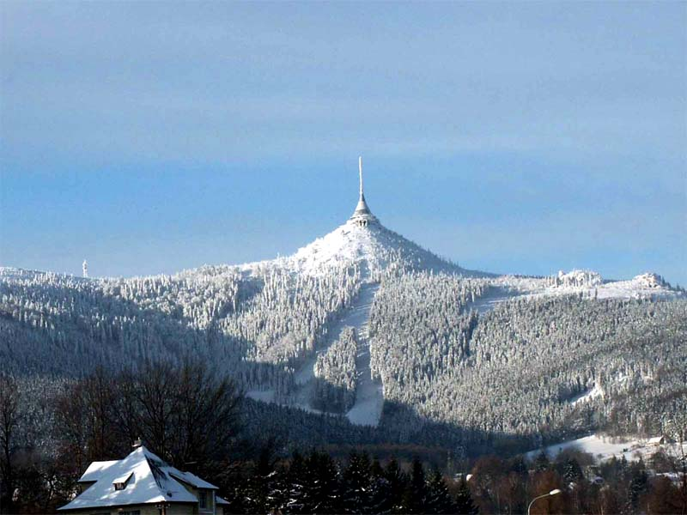
Places of natural beauty
What are these places? What are they famous for?

Slide 12
Places of natural beauty
Moravian karst – famous for caves and
the underground Punkva river
Adrspach rocky town – a popular
climbing area
Ještěd mountain – famous for the building on the top
Which places do you find interesting or beautiful?

Slide 13
Zdroje
http://www.google.cz/imgres?hl=cs&sa=X&tbo=d&gl=cz&biw=1024&bih=687&tbm=isch&tbnid=lYHMr--AH4SoKM:&imgrefurl=http://www.realit.cz/aktualita/karlovy-vary-chteji-pri-tendrech-na-stavby-usetrit-miliony-korun&docid=fPtuvvy0WZ-2bM&imgurl=http://www.realit.cz/files/imagecache/dust_filerenderer_big/files/upload/story_online/karlovy_vary_4dce33fbf2.jpg&w=800&h=600&ei=NKzmUOH5JYeRhQezzoCICA&zoom=1&iact=hc&vpx=2&vpy=62&dur=118&hovh=194&hovw=259&tx=112&ty=90&sig=117809575946673020716&page=1&tbnh=144&tbnw=181&start=0&ndsp=20&ved=1t:429,r:0,s:0,i:154
http://www.google.cz/imgres?hl=cs&tbo=d&gl=cz&biw=1024&bih=687&tbm=isch&tbnid=gAuVkZAtbvLqRM:&imgrefurl=http://www.pobytovebalicky.cz/pobytove-balicky/pobyty-pro-seniory/407_marianske-lazne-darkovy-poukaz-v-hodnote-5.000-kc.html&docid=pWfHMTMz1IGE5M&imgurl=http://www.pobytovebalicky.cz/web_images/b_13_marianske-lazne_fontana_01_407_241.jpg&w=780&h=518&ei=wKzmULb2M82ZhQe08oHgBQ&zoom=1&iact=hc&vpx=706&vpy=308&dur=2227&hovh=183&hovw=276&tx=181&ty=100&sig=117809575946673020716&page=2&tbnh=148&tbnw=225&start=20&ndsp=25&ved=1t:429,r:24,s:0,i:215
http://www.google.cz/imgres?hl=cs&tbo=d&gl=cz&biw=1024&bih=687&tbm=isch&tbnid=KT5UBlqlbt9IQM:&imgrefurl=http://www.luhacovice.cz/1333-lazne-luhacovice&docid=ZErL0j4SwJ9QFM&imgurl=http://www.luhacovice.cz/wcd/photos/lazne-velike/jurkovicuv-dum-vodotrysk.jpg&w=700&h=465&ei=Gq3mUIjvIMHPhAe89ID4DQ&zoom=1&iact=hc&vpx=2&vpy=188&dur=2110&hovh=183&hovw=276&tx=143&ty=113&sig=117809575946673020716&page=1&tbnh=141&tbnw=198&start=0&ndsp=20&ved=1t:429,r:5,s:0,i:153
http://www.google.cz/imgres?q=Karlstejn&um=1&hl=cs&tbo=d&biw=1280&bih=795&tbm=isch&tbnid=3m5usIq4t06MKM:&imgrefurl=http://http://www.google.cz/imgres?hl=cs&tbo=d&gl=cz&biw=1024&bih=687&tbm=isch&tbnid=pxg0hQIFmAQInM:&imgrefurl=http://www.lazenskepobyty.cz/lazne-jachymov/&docid=yaJqwPBbpX73RM&imgurl=http://www.lazenskepobyty.cz/lazne-jachymov/images/radium2-big.jpg&w=510&h=385&ei=aa3mUJqlG4nAhAfx2YDYBQ&zoom=1&iact=hc&vpx=724&vpy=159&dur=715&hovh=195&hovw=258&tx=167&ty=111&sig=117809575946673020716&page=1&tbnh=136&tbnw=183&start=0&ndsp=20&ved=1t:429,r:4,s:0,i:124
http://www.google.cz/imgres?um=1&hl=cs&sa=N&tbo=d&gl=cz&biw=1024&bih=687&tbm=isch&tbnid=2MsJf15GryIh0M:&imgrefurl=http://www.brno.me/vylety.php&docid=QZcTT0Ri4ob1PM&imgurl=http://www.brno.me/photos/trip/telc_town.jpg&w=657&h=555&ei=PrTmUMmNOMXCswazoIC4Dw&zoom=1&iact=hc&vpx=356&vpy=306&dur=943&hovh=206&hovw=244&tx=99&ty=148&sig=117809575946673020716&page=1&tbnh=142&tbnw=172&start=0&ndsp=20&ved=1t:429,r:7,s:0,i:162
http://www.google.cz/imgres?um=1&hl=cs&tbo=d&gl=cz&biw=1024&bih=687&tbm=isch&tbnid=flrYT3fInSdN-M:&imgrefurl=http://www.zamky-hrady.cz/1/cesky_krumlov.htm&docid=cJzIErH8u7OzwM&imgurl=http://www.zamky-hrady.cz/1/img/zk%25252001.jpg&w=389&h=265&ei=frTmULyQBYjatAb-6IGwAg&zoom=1&iact=hc&vpx=381&vpy=390&dur=2232&hovh=185&hovw=272&tx=145&ty=101&sig=117809575946673020716&page=1&tbnh=138&tbnw=196&start=0&ndsp=20&ved=1t:429,r:12,s:0,i:187
http://www.google.cz/imgres?um=1&hl=cs&tbo=d&gl=cz&biw=1024&bih=687&tbm=isch&tbnid=HORQNTv6JAVSLM:&imgrefurl=http://www.kutnahora.cz/&docid=-EdQtby9zAnZRM&imgurl=http://www.kutnahora.cz/data/pageadds/66_panorama-pic1-orez_low.jpg&w=400&h=183&ei=5LTmUJXZBovNsgbU-4DoBQ&zoom=1&iact=hc&vpx=2&vpy=183&dur=2181&hovh=146&hovw=320&tx=159&ty=78&sig=117809575946673020716&page=1&tbnh=136&tbnw=272&start=0&ndsp=20&ved=1t:429,r:0,s:0,i:151
http://www.google.cz/imgres?hl=cs&sa=X&tbo=d&gl=cz&biw=1024&bih=687&tbm=isch&tbnid=yPfi1v6QTk-b_M:&imgrefurl=http://www.lednice.org/home.htm&docid=IQaSd8JWGIBopM&imgurl=http://www.lednice.org/images/photos/big/zamek_lednice.jpg&w=600&h=408&ei=2r7mUK3MAsKItQb-64CYAw&zoom=1&iact=hc&vpx=170&vpy=173&dur=1869&hovh=185&hovw=272&tx=127&ty=93&sig=117809575946673020716&page=1&tbnh=136&tbnw=192&start=0&ndsp=15&ved=1t:429,r:11,s:0,i:148
http://www.google.cz/imgres?hl=cs&tbo=d&gl=cz&biw=1024&bih=687&tbm=isch&tbnid=Tp_npaDoh3WPpM:&imgrefurl=http://www.cestujemesdetmi.cz/%3Fp%3D42005&docid=dWkUVQVQmz_-UM&imgurl=http://www.cestujemesdetmi.cz/wp-content/uploads/2012/09/Z%2525C3%2525A1mek-Hlubok%2525C3%2525A1-1.jpg&w=1280&h=849&ei=JL_mUNWSEsjXtAbnh4CYDA&zoom=1&iact=hc&vpx=706&vpy=392&dur=2328&hovh=183&hovw=276&tx=158&ty=95&sig=117809575946673020716&page=1&tbnh=137&tbnw=207&start=0&ndsp=20&ved=1t:429,r:14,s:0,i:127 l
http://www.google.cz/imgres?hl=cs&tbo=d&gl=cz&biw=1024&bih=687&tbm=isch&tbnid=-3xtUBtmcsj-gM:&imgrefurl=http://www.rr-strednimorava.cz/photo_full/zamek-novy-svetlov-v-1&docid=qU-AqrMRs14oqM&imgurl=http://www.rr-strednimorava.cz/uploads/gallery/full/35.jpg&w=600&h=400&ei=d7_mULmEEYjasgaQyoDABQ&zoom=1&iact=hc&vpx=350&vpy=380&dur=136&hovh=183&hovw=275&tx=157&ty=163&sig=117809575946673020716&page=1&tbnh=140&tbnw=195&start=0&ndsp=20&ved=1t:429,r:12,s:0,i:121
http://www.google.cz/imgres?hl=cs&tbo=d&gl=cz&biw=1024&bih=687&tbm=isch&tbnid=vIBSLiagmtdT2M:&imgrefurl=http://www.valtice-zamek.cz/&docid=mK7eEzR5qLbbcM&imgurl=http://www.ubytovani-valtice.cz/picture/miniweby/celni-pohled-valtice-zamek.jpg&w=510&h=395&ei=2r_mUNXUB9DVsgavsoHwBw&zoom=1&iact=hc&vpx=579&vpy=308&dur=3142&hovh=198&hovw=255&tx=178&ty=109&sig=117809575946673020716&page=1&tbnh=141&tbnw=171&start=0&ndsp=20&ved=1t:429,r:8,s:0,i:149
http://www.google.cz/imgres?hl=cs&tbo=d&gl=cz&biw=1024&bih=687&tbm=isch&tbnid=TmPGXYT2TVtAkM:&imgrefurl=http://www.kras.unas.cz/prvni.htm&docid=cACvapzzQE8C1M&imgurl=http://www.kras.unas.cz/obr/balcarka/balc2.jpg&w=350&h=228&ei=N8HmUPaZCcfotQaO44DoBQ&zoom=1&iact=hc&vpx=408&vpy=382&dur=2161&hovh=181&hovw=278&tx=109&ty=94&sig=117809575946673020716&page=1&tbnh=130&tbnw=205&start=0&ndsp=23&ved=1t:429,r:14,s:0,i:127
http://www.google.cz/imgres?hl=cs&tbo=d&gl=cz&biw=1024&bih=687&tbm=isch&tbnid=wCtvlMsoBUdg0M:&imgrefurl=http://www.tvezdravi.cz/krasna-mista.html&docid=kvmSMCgV_rTXaM&imgurl=http://www.tvezdravi.cz/photos/doporucujeme/54253500adrspach2.jpg&w=600&h=479&ei=csHmULjrDMLXtAaJg4GwCg&zoom=1&iact=hc&vpx=731&vpy=67&dur=2344&hovh=201&hovw=251&tx=189&ty=116&sig=117809575946673020716&page=1&tbnh=133&tbnw=167&start=0&ndsp=25&ved=1t:429,r:5,s:0,i:114

