Slide 1

Sports
Tematická oblast | Angličtina: The Czech Republic
Datum vytvoření | 5. 1. 2013
Ročník | 2. - 4., sexta – oktáva, úroveň B1
Stručný obsah | Sporty oblíbené, masové; vrcholoví sportovci
Způsob využití | Stručné povídání na téma sport v České republice. Forma otázek a cvičení
Autor | Mgr. Jiřina Juříčková
Kód | VY_32_INOVACE_06_AJUR07
Gymnázium a Jazyková škola s právem státní jazykové zkoušky Zlín

Slide 2
Czech Republic
Sports

Slide 3
Can you?
Name some of the popular sports in the Czech Republic?
Name the most popular summer and winter sports?
Name Czech national sports?
Name some famous or important sportsmen or sportswomen?
Name some areas where sports (summer or winter) are practised?

Slide 4
Sports
Circle sports popular in the Czech Republic: winter sports in yellow, summer sports in green, national sports in blue
Ice hockey cycling tennis golf
Curling football basketball handball
Swimming volleyball athletics gymnastics
Rugby jogging skiing hiking
Canoeing aerobics body building racing

Slide 5
Sports
Circle sports popular in the Czech Republic: winter sports in yellow, summer sports in green, national sports in blue
Ice hockey cycling tennis golf
Curling football basketball handball
Swimming volleyball athletics gymnastics
Rugby jogging skiing hiking
Canoeing aerobics body building racing

Slide 6
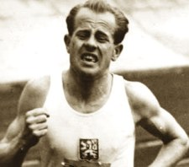
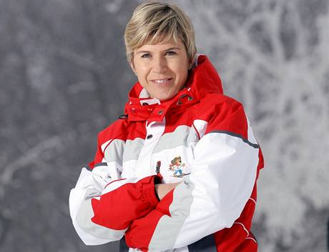
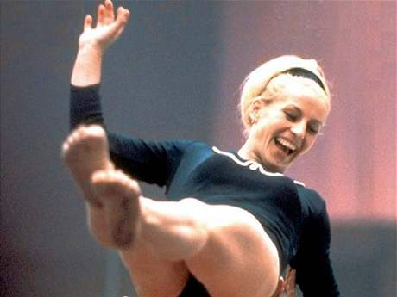
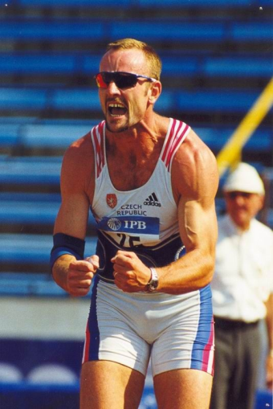

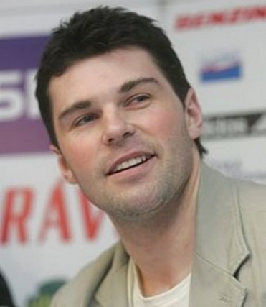
Sportsmen and sportswomen
Do you know these sportsmen and sportswomen? Do you know which sports they practised or practise
A
B
C
D
E
F

Slide 7
Sportsmen and sportswomen
A Emil Zátopek athletics/running
B Kateřina Neumannová cross-country skiing
C Věra Čáslavská gymnastics
D Tomáš Dvořák athletics/decathlon
E Martina Navrátilová tennis
F Jaromír Jágr ice hockey
Do you know any other famous Czech sportsmen or sportswomen?
Do you know sports they do or did and what they have achieved or achieved?

Slide 8
Popular summer sports
In summer Czech people like going cycling and hiking, quite a lot of them like canoeing.
The most popular cycling area is probably Southern Bohemia for its wonderful countryside and not that hilly landscape.
Hiking areas are mainly in the mountains and the rocky towns of Adrspach or Teplicke.
The Vltava, Sázava or Ohře are the most popular rivers suitable for canoeing.

Slide 9
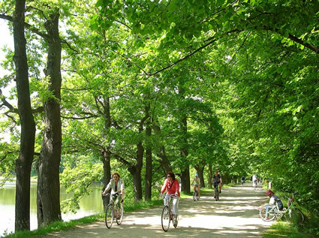
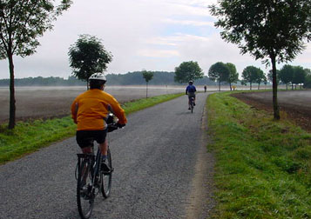
Cycling in Southern Bohemia

Slide 10
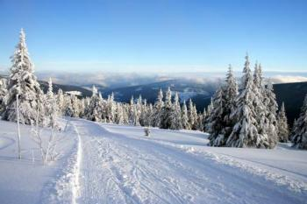
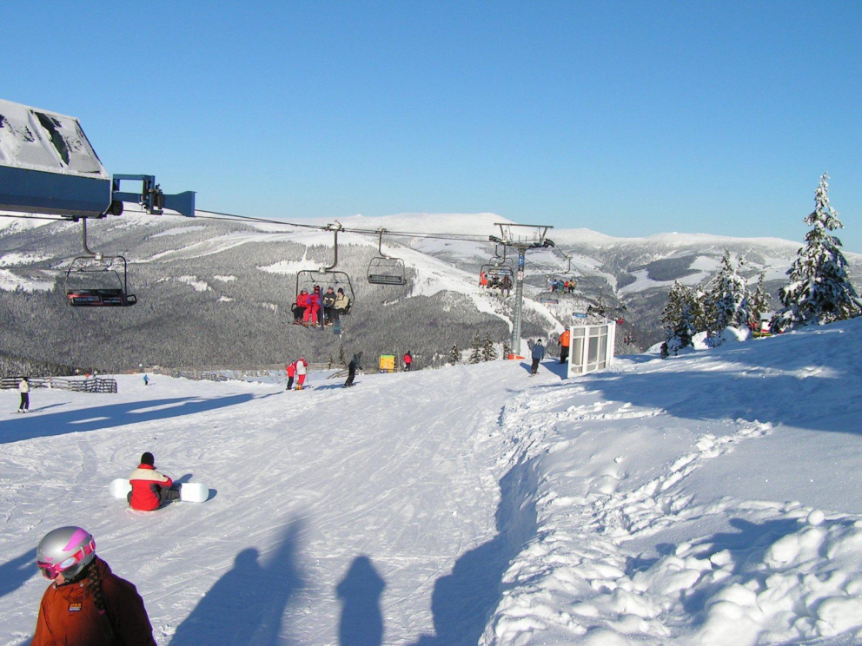
Popular winter sports
In winter a lot of Czech people do skiing to the mountains. Cross-country skiing is another popular activity.

Slide 11
And what about you?
What sports do you do in summer and in winter?
Do you do sports with your friends or your family?
Do you like team sports or individual sports?

Slide 12
Zdroje
http://www.google.cz/imgres?imgurl=http://www.atletickytrenink.cz/Slavni_atleti/Emil.jpg&imgrefurl=http://www.atletickytrenink.cz/Slavni_atleti/zatopek.php&h=198&w=225&sz=10&tbnid=OpAfdBGDqzieXM:&tbnh=90&tbnw=102&zoom=1&usg=__bkiu9fxlr_HwlWyR4sBuwsqDJpA=&docid=66W8_c8gAGqZEM&hl=cs&sa=X&ei=-rDpUJiQE4XQsga8-IHgBw&ved=0CEgQ9QEwAw&dur=1832
http://www.google.cz/imgres?um=1&hl=cs&sa=N&tbo=d&biw=1280&bih=656&tbm=isch&tbnid=pZFboJsIFgdyPM:&imgrefurl=http://ball71.com/martina-navratilova.html&docid=6-sxE71-NKFSJM&imgurl=http://ball71.com/images/Martina-Navratilova.jpg&w=1200&h=1800&ei=YbHpUP_CDYfXsga7k4CIBA&zoom=1&iact=hc&vpx=808&vpy=122&dur=2132&hovh=275&hovw=183&tx=94&ty=156&sig=104645909987912854339&page=1&tbnh=143&tbnw=94&start=0&ndsp=23&ved=1t:429,r:5,s:0,i:117
http://www.google.cz/imgres?imgurl=http://i.idnes.cz/08/083/gal/BER1ac702_caslavska1spf.jpg&imgrefurl=http://zpravy.idnes.cz/v-bratrove-smrti-ma-prsty-stb-rika-vera-caslavska-f7k-/domaci.aspx?c%3DA080820_073135_domaci_lpo&h=345&w=460&sz=16&tbnid=eU5pmR-y1MzaqM:&tbnh=92&tbnw=122&zoom=1&usg=__40mENbUWBT2DD7Tz3P_PhfCLyXQ=&docid=4ExqSDAztvYNwM&hl=cs&sa=X&ei=67HpUOKrCoHTtAb08IGIAw&sqi=2&ved=0CE4Q9QEwBQ&dur=3350
http://www.google.cz/imgres?imgurl=http://www.svobodagroup.cz/Portals/0/Obrazky/Galerie/Zavody/Dvorak/bez%2520n%C3%A1zvu.jpg&imgrefurl=http://www.svobodagroup.cz/Fotogalerie/Z%25C3%25A1vody/B%25C3%25BDval%25C3%25ADsv%25C4%259B%25C5%2599enci/Tom%25C3%25A1%25C5%25A1Dvo%25C5%2599%25C3%25A1k/tabid/127/Default.aspx&h=800&w=534&sz=62&tbnid=zI_gWi8_-5T5fM:&tbnh=94&tbnw=63&zoom=1&usg=__ZvyAtKfgpqiEXJ9OtRGIhVDRwmQ=&docid=QDOa9w71BO3R3M&hl=cs&sa=X&ei=K7LpUIOnLInYtAaY44G4Bg&sqi=2&ved=0CD0Q9QEwAQ&dur=8174
http://www.google.cz/imgres?imgurl=http://blog.areal.cz/wp-content/jaromir_jagr.jpg&imgrefurl=http://blog.areal.cz/?p%3D68&h=478&w=415&sz=30&tbnid=7yWjUwXqVPkcZM:&tbnh=90&tbnw=78&zoom=1&usg=__O5YrZAf2T460siZLSw83UYfVNwM=&docid=ffzwKHMh-6EEVM&hl=cs&sa=X&ei=gbLpUNKxAc_ntQaGmIHABw&sqi=2&ved=0CE4Q9QEwBQ&dur=1895
http://www.google.cz/imgres?um=1&hl=cs&sa=N&tbo=d&biw=1280&bih=656&tbm=isch&tbnid=zuLEKit4n12_7M:&imgrefurl=http://sport.idnes.cz/neumannova-mame-dluhy-precenili-jsme-kolik-prijede-divaku-p36-/lyzovani.aspx%3Fc%3DA090619_085638_lyzovani_par&docid=SIDl1RaOY3rZoM&imgurl=http://i.idnes.cz/09/012/gal/KAL2878fa_152144_4153415.jpg&w=460&h=353&ei=F7PpUJCNLMGZtQaGiYHADA&zoom=1&iact=hc&vpx=981&vpy=127&dur=1638&hovh=197&hovw=256&tx=150&ty=111&sig=104645909987912854339&page=1&tbnh=146&tbnw=184&start=0&ndsp=22&ved=1t:429,r:7,s:0,i:109
http://www.google.cz/imgres?um=1&hl=cs&tbo=d&biw=1280&bih=656&tbm=isch&tbnid=P279DXQhv9oImM:&imgrefurl=http://www.transitionsabroad.com/listings/travel/articles/bicycle-travel-in-bohemia-czech-replublic.shtml&docid=zumkeyAPYv0pYM&imgurl=http://www.transitionsabroad.com/listings/travel/articles/images/pearl-cycling-bohemia-czech-republic-path.jpg&w=425&h=317&ei=dbbpUL-RBofasgacjoGICA&zoom=1&iact=hc&vpx=673&vpy=330&dur=981&hovh=194&hovw=260&tx=135&ty=146&sig=104645909987912854339&page=3&tbnh=147&tbnw=200&start=53&ndsp=29&ved=1t:429,r:65,s:0,i:285
http://www.google.cz/imgres?um=1&hl=cs&tbo=d&biw=1280&bih=656&tbm=isch&tbnid=u-hI1E5MabTVxM:&imgrefurl=http://www.firstlightbicycletours.com/2012/04/26/czech-republic-cycling-southern-bohemia-sojourn/&docid=fTrAQFzbJ9LHcM&imgurl=http://www.firstlightbicycletours.com/wp-content/gallery/southern-bohemia-soujourn/morning-fields.jpg&w=357&h=252&ei=dbbpUL-RBofasgacjoGICA&zoom=1&iact=hc&vpx=135&vpy=131&dur=2638&hovh=189&hovw=267&tx=180&ty=107&sig=104645909987912854339&page=1&tbnh=146&tbnw=206&start=0&ndsp=24&ved=1t:429,r:1,s:0,i:88
http://www.google.cz/imgres?um=1&hl=cs&tbo=d&biw=1280&bih=656&tbm=isch&tbnid=jmCDSP6amqloGM:&imgrefurl=http://apartmany.topfirma.cz/stranka-krkonose-30&docid=1CVGM7pwnJ61-M&imgurl=http://apartmany.topfirma.cz/obr-dobry-duvod-pro-nadhernou-dovolenou-prave-v-krkonosich-26&w=350&h=233&ei=0LfpUJjqF8XktQaR-ICYAw&zoom=1&iact=hc&vpx=602&vpy=170&dur=1979&hovh=183&hovw=275&tx=122&ty=128&sig=104645909987912854339&page=1&tbnh=147&tbnw=212&start=0&ndsp=17&ved=1t:429,r:3,s:0,i:108
http://www.google.cz/imgres?um=1&hl=cs&tbo=d&biw=1280&bih=656&tbm=isch&tbnid=vf0jBhX51TJfMM:&imgrefurl=http://www.hotelklik.cz/cz/clanek/53/lokalita/Last_Moment_Zima_2011/&docid=tSKNEPDPMnX7iM&imgurl=http://www.hotelklik.cz/images/clanky/-PICT0016.JPG&w=1600&h=1200&ei=0LfpUJjqF8XktQaR-ICYAw&zoom=1&iact=hc&vpx=441&vpy=16&dur=1025&hovh=194&hovw=259&tx=108&ty=96&sig=104645909987912854339&page=2&tbnh=145&tbnw=192&start=17&ndsp=24&ved=1t:429,r:25,s:0,i:179

