Slide 1

Great Czechs
Tematická oblast | Angličtina: The Czech Republic
Datum vytvoření | 6. 1. 2013
Ročník | 2. - 4., sexta – oktáva, úroveň B1
Stručný obsah | Některé z významných osobností
Způsob využití | Formou jednoduchých cvičení připomenout některé z významných osobností českých dějin
Autor | Mgr. Jiřina Juříčková
Kód | VY_32_INOVACE_06_AJUR08
Gymnázium a Jazyková škola s právem státní jazykové zkoušky Zlín

Slide 2
Czech Republic
Great Czechs

Slide 3
Do you know?
The Czech Republic is a small country but it has got quite a lot of important or famous personalities that influenced not only the country and its life but also the whole world. Do you know any of them?
Do you know any famous or important scientists?
Do you know any famous or important politicians?
Do you know any famous or important writers?
Do you know any famous or important sportsmen or sportswomen?

Slide 4
Can you?
Can you match the following personalities to their field of work/study?
Charles IV literature
Otto Wichterle medicine
Václav Havel politics
Jarolsav Seifert sport
Jaroslav Heyrovský music
Emil Zátopek chemistry
Věra Čáslavská
Karel Čapek
Antonín Dvořák
Bohdan Pomahač

Slide 5
Can you?
Can you match the following personalities to their field of work/study?
Charles IV politics
Otto Wichterle chemistry
Václav Havel politics
Jaroslav Seifert literature
Jaroslav Heyrovský chemistry
Emil Zátopek sports
Věra Čáslavská sports
Karel Čapek literature
Antonín Dvořák music
Bohdan Pomahač medicine

Slide 6
Can you?
Can you match the following personalities to their greatest achievements?
Charles IV Nobel prizewinner
Otto Wichterle foundation of the republic
Václav Havel the greatest importance of the country
Jaroslav Seifert invention of the contact lenses
Jaroslav Heyrovský 1st president of the CR
T. G. Masaryk invention of one specific word
Karel Čapek Nobel prizewinner

Slide 7
Can you?
Can you match the following personalities to their greatest achievements?
Charles IV the greatest importance of the country
Otto Wichterle invention of the contact lenses
Václav Havel 1st president of the CR
Jaroslav Seifert Nobel prizewinner
Jaroslav Heyrovský Nobel prizewinner
T. G. Masaryk foundation of the republic
Karel Čapek invention of one specific word

Slide 8
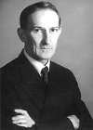
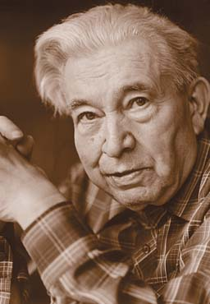
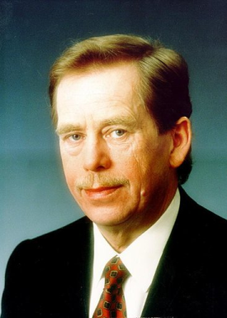
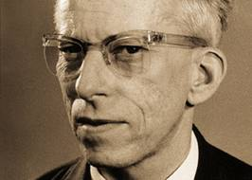
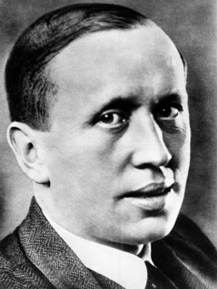
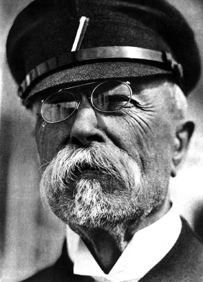
Can you?
Can you match the following personalities to their images?
Charles IV
Otto Wichterle
Václav Havel
Jaroslav Seifert
Jaroslav Heyrovský
T. G. Masaryk
Karel Čapek

Slide 9
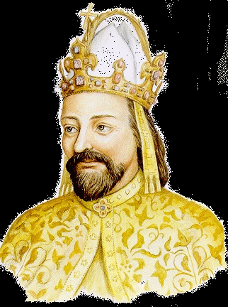
Can you?
Can you match the following personalities to their images?
Jaroslav Heyrovský
Jaroslav Seifert
Václav Havel
Otto Wichterle
Karel Čapek
Charles IV
T. G. Masaryk

Slide 10
Zdroje
http://www.converter.cz/nobel/heyrovsky.htm
http://www.google.cz/imgres?imgurl=http://www.literaturaspse.ic.cz/obrazky/autori/seifert.jpg&imgrefurl=http://www.literaturaspse.ic.cz/Seifert.html&h=370&w=256&sz=29&tbnid=Lx1s0Y0ZLHLjpM:&tbnh=97&tbnw=67&zoom=1&usg=__aZDHi7OoHI9nb_zIRqnDmPxAFT0=&docid=2qtQ6Y1BbhdoFM&hl=cs&sa=X&ei=nNTpUNOMMtHZsganq4D4BQ&sqi=2&ved=0CEwQ9QEwBA&dur=255
http://www.google.cz/imgres?imgurl=http://www.provaseoci.cz/articles/201010192258wichterle.jpg&imgrefurl=http://www.provaseoci.cz/article.php?clanek%3D20101019012152%26id_kapitoly%3D03%26id_podkapitoly%3D03&h=500&w=700&sz=200&tbnid=-y0JnKW-z1eZWM:&tbnh=90&tbnw=126&zoom=1&usg=__hidLb06k-eWWSN9hIVo3L4PjsOA=&docid=8lck-bDvYcIGgM&hl=cs&sa=X&ei=3tTpUI-XB4nNswbisoDQAw&sqi=2&ved=0CEMQ9QEwAw&dur=3278
http://www.google.cz/imgres?imgurl=http://www.karelcapek.chytry.cz/images/capek.jpg&imgrefurl=http://www.karelcapek.chytry.cz/galerie.html&h=347&w=261&sz=40&tbnid=Srk18afLcR-onM:&tbnh=90&tbnw=68&zoom=1&usg=__iXFsloj7cLMsSZo9_yFR2AIkMTk=&docid=SZ1V-mdx9DKOJM&hl=cs&sa=X&ei=NtXpUJPJEcrDtAaR-IHYDw&sqi=2&ved=0CFEQ9QEwBQ&dur=218
http://www.google.cz/imgres?imgurl=http://www.e-polis.cz/pic/masaryk.jpg&imgrefurl=http://www.e-polis.cz/politicke-teorie/415-problem-maleho-naroda-a-masarykuv-nacionalismus.html&h=763&w=550&sz=100&tbnid=AFGqrZ6-UnZnNM:&tbnh=90&tbnw=65&zoom=1&usg=__lIkCZUTub_HuI6uDLc1BjNDJtYc=&docid=Lp0CnICfZWPI_M&hl=cs&sa=X&ei=vdXpULGwKonVtAbKn4CgBg&ved=0CEMQ9QEwAw&dur=5450
http://www.google.cz/imgres?imgurl=http://www.dejepis.com/img/havel.jpg&imgrefurl=http://www.dejepis.com/index.php?page%3D000%26kap%3D026%26pod%3D5&h=512&w=366&sz=33&tbnid=ddCt6MirCGEZ8M:&tbnh=90&tbnw=64&zoom=1&usg=__xcxd5-5STdKZME-LvXo3IgBZ7HU=&docid=u7ZN9e8QE7EL4M&hl=cs&sa=X&ei=u9bpUOySB4fZtAb4w4HYBA&ved=0CEkQ9QEwBA&dur=2589
http://www.google.cz/imgres?imgurl=http://www.gvp.cz/~janotova/Karel%2520IV1.gif&imgrefurl=http://www.gvp.cz/~janotova/obrazky.htm&h=432&w=322&sz=69&tbnid=Hdj6kLyvNg9s6M:&tbnh=90&tbnw=67&zoom=1&usg=__JnY65YiRx3ols38KfyUgcVTa5sc=&docid=XBUTgnijK_sdzM&hl=cs&sa=X&ei=SdfpUKC7B8nktQaD74CYCw&ved=0CFYQ9QEwAw&dur=6944

