Slide 1

UNESCO sights
Tematická oblast | Angličtina: The Czech Republic
Datum vytvoření | 3. 1. 2013
Ročník | 2. - 4., sexta – oktáva, úroveň B1
Stručný obsah | Místa v ČR zapsaná na seznam památek UNESCO
Způsob využití | Formou jednoduchých cvičení připomenout některá z významných míst České republiky
Autor | Mgr. Jiřina Juříčková
Kód | VY_32_INOVACE_06_AJUR09
Gymnázium a Jazyková škola s právem státní jazykové zkoušky Zlín

Slide 2
Czech Republic
UNESCO sights

Slide 3
The wonders of the Czech Republic
Thanks to the long history of the country there are numerous historical places like castles, churches, palaces or even whole city centres. Some of these are so unique that they are listed on the UNESCO list of the world heritage sights.
Can you name any of these places?
Are any of them in your region?
Have you visited any of them?

Slide 4
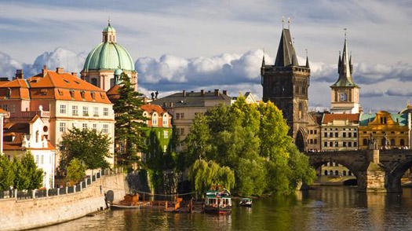
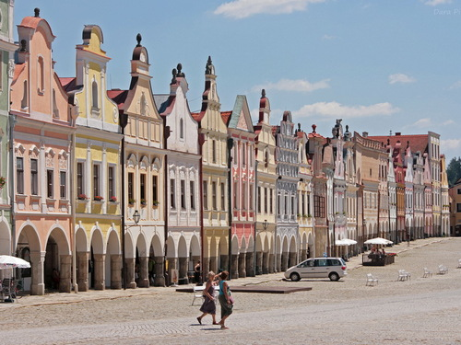
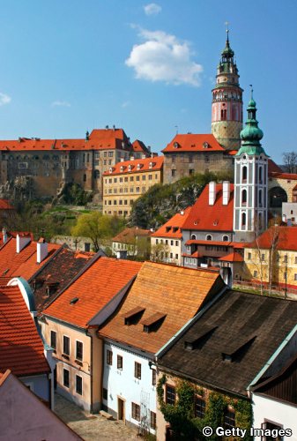
Historical centres on the UNESCO list
Do you know them?

Slide 5
Historical centres on the UNESCO list
Do you know them?
Prague
Telč
Český Krumlov

Slide 6
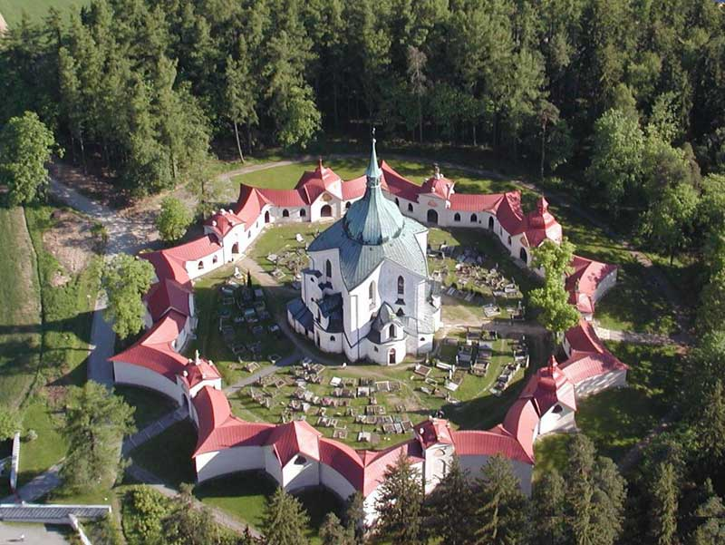
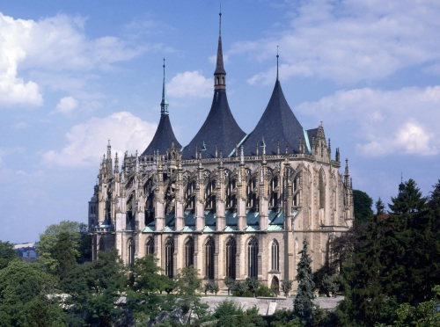
Churches on the UNESCO list
Do you know them?

Slide 7
Churches on the UNESCO list
Do you know them?
The Pilgrimage Church of Jan Nepomuk in Zelená Hora
The Church of St. Barbara

Slide 8
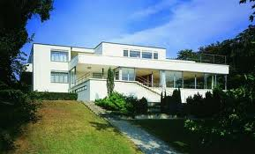
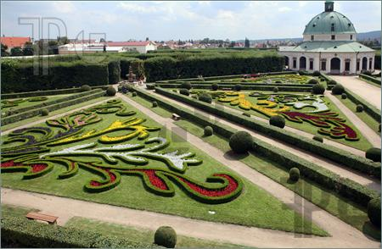
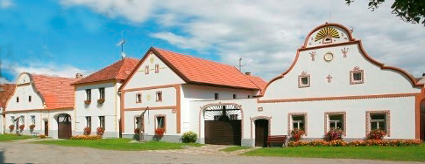
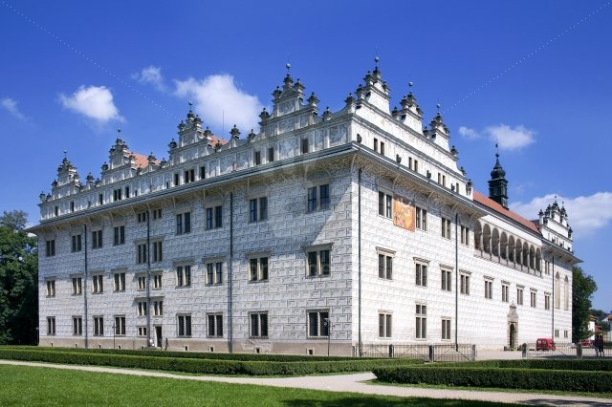
Other places on the UNESCO list
Do you know them?

Slide 9
Other places on the UNESCO list
Do you know them?
Villa Tugendhat, Brno
Kromeriz Castle and gardens
Holasovice
Litomysl Castle

Slide 10
Zdroje
http://www.google.cz/imgres?um=1&hl=cs&sa=N&tbo=d&qscrl=1&rlz=1T4ASUS_cs___CZ419&biw=1280&bih=656&tbm=isch&tbnid=sdscbta2QOE64M:&imgrefurl=http://www.time.com/time/travel/cityguide/article/0,31489,1925095,00.html&docid=_D6MjqbJnyBIWM&imgurl=http://img.timeinc.net/time/europe/magazine/2009/0914/prague_tout.jpg&w=525&h=294&ei=E9zpUNz7CoiZtQaSpoG4Aw&zoom=1&iact=hc&vpx=937&vpy=134&dur=2825&hovh=168&hovw=300&tx=176&ty=78&sig=104645909987912854339&page=1&tbnh=132&tbnw=239&start=0&ndsp=19&ved=1t:429,r:5,s:0,i:103
http://www.google.cz/imgres?um=1&hl=cs&tbo=d&qscrl=1&rlz=1T4ASUS_cs___CZ419&biw=1280&bih=656&tbm=isch&tbnid=3sz4RspLq6JGYM:&imgrefurl=http://www.gogobot.com/historic-centre-of-telc-telc-attraction&docid=DYmkM2UAfJSxLM&imgurl=http://cdn4.gbot.me/photos/jS/OK/1323684801/Tel_-Historic_Centre_of_Tel__-20000000002264679-500x375.jpg&w=500&h=375&ei=XdzpUOqhBoXitQapnoCwAQ&zoom=1&iact=hc&vpx=833&vpy=272&dur=3160&hovh=194&hovw=259&tx=139&ty=97&sig=104645909987912854339&page=1&tbnh=138&tbnw=176&start=0&ndsp=24&ved=1t:429,r:10,s:0,i:115
http://www.google.cz/imgres?um=1&hl=cs&tbo=d&qscrl=1&rlz=1T4ASUS_cs___CZ419&biw=1280&bih=656&tbm=isch&tbnid=drJJwYctoGcZOM:&imgrefurl=http://world_heritage.jaxa.jp/en/search/detail.php%3Ffroml%3Dlist%26from%3Dcategory%26id%3D539&docid=p0lS7KFotZ7gUM&imgurl=http://world_heritage.jaxa.jp/images/heritage/description/ph0539_l.jpg&w=337&h=500&ei=vNzpUJXBH4jLswbovIHQAg&zoom=1&iact=hc&vpx=388&vpy=236&dur=3487&hovh=274&hovw=184&tx=96&ty=143&sig=104645909987912854339&page=1&tbnh=148&tbnw=97&start=0&ndsp=26&ved=1t:429,r:8,s:0,i:109
http://www.google.cz/imgres?um=1&hl=cs&tbo=d&qscrl=1&rlz=1T4ASUS_cs___CZ419&biw=1280&bih=656&tbm=isch&tbnid=4nsIOey0m5ycaM:&imgrefurl=http://www.zamekzdar.cz/180-poutni-kostel-sv.-jana-nepomuckeho-na-zelene-hore.aspx&docid=2-3Ybox7G-SVHM&imgurl=http://www.zamekzdar.cz/user_img/gallery/180/zelena_hora_unesco_1b.jpg&w=800&h=601&ei=Od7pUJK4B4bfsgazjIDIBQ&zoom=1&iact=hc&vpx=576&vpy=125&dur=7863&hovh=195&hovw=259&tx=179&ty=102&sig=104645909987912854339&page=1&tbnh=140&tbnw=181&start=0&ndsp=24&ved=1t:429,r:3,s:0,i:94
http://www.google.cz/imgres?um=1&hl=cs&sa=X&tbo=d&qscrl=1&rlz=1T4ASUS_cs___CZ419&biw=1280&bih=656&tbm=isch&tbnid=w6xrtlY5g5l8uM:&imgrefurl=http://qool.cz/detail-mista/3170-chram-svate-barbory/&docid=C0fh7qNW8Yy5cM&imgurl=http://img.qool.cz/objects/id/3170/3.jpg&w=500&h=372&ei=xN7pUIvpFcTbtAbBqYGgDg&zoom=1&iact=hc&vpx=488&vpy=125&dur=1213&hovh=194&hovw=260&tx=109&ty=109&sig=104645909987912854339&page=1&tbnh=140&tbnw=192&start=0&ndsp=27&ved=1t:429,r:3,s:0,i:94
http://www.google.cz/imgres?um=1&hl=cs&tbo=d&qscrl=1&rlz=1T4ASUS_cs___CZ419&biw=1280&bih=656&tbm=isch&tbnid=Yj47_agkX2qvjM:&imgrefurl=http://www.realit.cz/aktualita/statiku-vily-tugendhat-narusila-voda-z-kanalizace-odhalila-sonda&docid=sUM20u9iRNYtJM&imgurl=http://www.realit.cz/files/imagecache/dust_filerenderer_big/files/upload/story_online/vila_tugendhat_4be3bef701.jpg&w=500&h=303&ei=99_pUKS2Bs3GswaO9IGYCg&zoom=1&iact=rc&dur=99&sig=104645909987912854339&page=1&tbnh=128&tbnw=224&start=0&ndsp=17&ved=1t:429,r:2,s:0,i:93&tx=143&ty=38
http://www.google.cz/imgres?um=1&hl=cs&tbo=d&qscrl=1&rlz=1T4ASUS_cs___CZ419&biw=1280&bih=656&tbm=isch&tbnid=23Bfm0if7mAjFM:&imgrefurl=http://www.featurepics.com/online/Flower-Garden-Castle-1608664.aspx&docid=deHd7r7f7lH5gM&imgurl=http://www.featurepics.com/FI/Thumb300/20100708/Flower-Garden-Castle-1608664.jpg&w=450&h=294&ei=W-DpUPqICorUtAarmoDoCg&zoom=1&iact=hc&vpx=959&vpy=190&dur=3552&hovh=181&hovw=278&tx=143&ty=101&sig=104645909987912854339&page=2&tbnh=139&tbnw=226&start=25&ndsp=24&ved=1t:429,r:36,s:0,i:198
http://www.google.cz/imgres?um=1&hl=cs&tbo=d&qscrl=1&rlz=1T4ASUS_cs___CZ419&biw=1280&bih=656&tbm=isch&tbnid=Mgg337vN6FlXQM:&imgrefurl=http://www.adam.cz/clanek-2009070039-xii-selske-slavnosti-holasovice-zvou-k-navsteve.html&docid=NCJV6q6s9vs4nM&imgurl=http://www.adam.cz/img/200907191734_Holasovice-UNESCO-selske-baroko.jpg&w=485&h=188&ei=0uDpULSCNdDFswaywYGQCg&zoom=1&iact=hc&vpx=601&vpy=146&dur=4845&hovh=140&hovw=361&tx=181&ty=86&sig=104645909987912854339&page=1&tbnh=109&tbnw=253&start=0&ndsp=24&ved=1t:429,r:3,s:0,i:94
http://www.google.cz/imgres?um=1&hl=cs&tbo=d&qscrl=1&rlz=1T4ASUS_cs___CZ419&biw=1280&bih=656&tbm=isch&tbnid=fwzHHq1lYbt1zM:&imgrefurl=http://www.profimedia.cz/fotografie/renesancni-zamek-litomysl-unesco-pardubicky-kraj-ceska/0005873947/&docid=VRpf0NuMnERMAM&imgurl=http://www.profimedia.cz/fotografie/renesancni-zamek-litomysl-unesco-pardubicky-kraj-ceska/profimedia-0005873947.jpg&w=640&h=426&ei=juHpUJvMD9HHtAaV-IHYBw&zoom=1&iact=hc&vpx=2&vpy=129&dur=3743&hovh=183&hovw=275&tx=137&ty=110&sig=104645909987912854339&page=1&tbnh=137&tbnw=204&start=0&ndsp=24&ved=1t:429,r:0,s:0,i:85

