Slide 1

Zlin region
Tematická oblast | Angličtina: The Czech Republic
Datum vytvoření | 8. 1. 2013
Ročník | 2. - 4., sexta – oktáva, úroveň B1
Stručný obsah | Základní informace o regionu v návaznosti na téma Česká republika
Způsob využití | Otázky na důležitá místa či osobnosti regionu
Autor | Mgr. Jiřina Juříčková
Kód | VY_32_INOVACE_06_AJUR10
Gymnázium a Jazyková škola s právem státní jazykové zkoušky Zlín

Slide 2
Czech Republic
Region Zlin

Slide 3
Region Zlin
Can you shortly characterise your region from the geographical point of view?
Do you know anything about its history?
Is your region an important one within the Czech Republic?
What can the region offer to the visitors?

Slide 4
Basic characteristics of the region Zlin
The region of Zlin is located in the eastern part of the Czech Republic, on the border with Slovakia.
Its landscape is mountainous in the north (the Beskydy mts.) and in the east (the White Carpathians), in the centre it is hilly and to the south and west the area gets flat (Slovácko and Haná regions). There is one major river – the Morava, the other rivers are in their upper courses and not very important.
As far as climate is concerned, the region lies on the edge of a warm zone in the south, the northern part lies in a cold zone.
The area of 3,964 km2 makes the region of Zlin a smaller region within the Czech Republic. Also the transportation connection with the rest of the republic is still not very good although the situation has improved lately.

Slide 5
The history of the region of Zlin
The history of the region is really rich and long. It was part of the core area of Great Moravia – a Slavic state founded in 833 by Mojmir. At that time he united two neighbouring states – the “Principality of Nitra” and the “Principality of Moravia”.
Shortly after that Cyril and Methodius came (about 863) and brought cultural development.
The modern history of this region is mainly linked to Tomas Baťa and the shoe factory founded there in 1894. The company soon brought a remarkable economic growth and prosperity to the area of the town of Zlin. This time is also strongly connected with functionalist architectural style which is typical for the whole city.

Slide 6
The importance of the region
The region is not important as an industrial centre nor as a crossroads of important transportation links. But it is quite important as a tourist area.
In the region there are also very important spiritual places such as Velehrad basilica, where two Slavic missionaries, Saints Cyril and Methodius, began preaching Christianity at this place. The importance of this place is not limited to the Zlin region or Moravia or even the Czech Republic. The basilica in Velehrad is very important for thousands of Christians from all around Europe.
And there is another important place in the region. It is Saint Hostýn, a hill with a basilica of Saint Mary. This place is an important Marian place of pilgrimage.

Slide 7
“Must see” in the region
There are a lot of places people coming to the region should visit. Except for the pilgrimage places of Velehrad and Hostýn, there are wonderful castles of Buchlovice or Lešná and we must not forget the Archbishop`s Palace and gardens in Kroměříž which are inscribed on the UNESCO World Heritage list.
From the educational point of view open-air museums in Rožnov pod Radhoštěm and Modrá should be mentioned. They show the visitors the ways people lived in the past.
While visiting our region, tourists should not miss the Baťa Canal, a historical waterway which once was started to join the region with the Danube and the Black Sea.
Various folk traditions and customs such as the Ride of the Kings in Vlčnov should be mentioned as well.

Slide 8
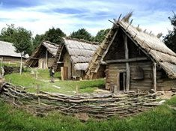
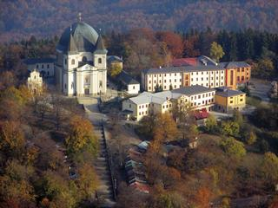
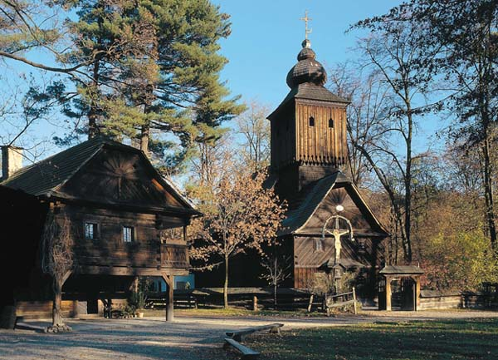
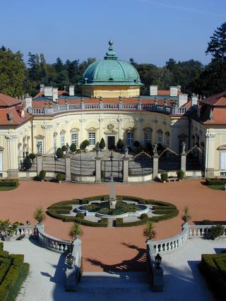
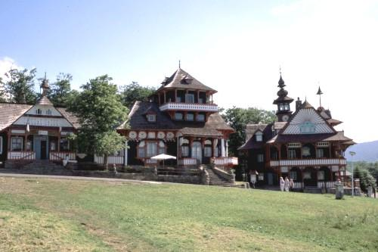
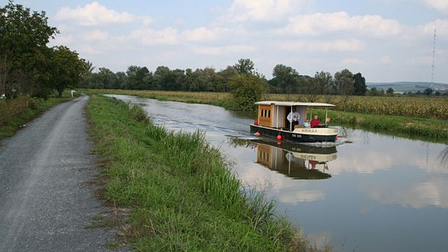
Can you name them?

Slide 9
Can you name them?
Modrá
Saint Hostýn
Rožnov pod Radhoštěm
Baťův kanál
Buchlovice
Pustevny

Slide 10
Zdroje
http://www.google.cz/imgres?hl=cs&sa=X&tbo=d&biw=1280&bih=656&tbm=isch&tbnid=uq5cjWjjHCqT6M:&imgrefurl=http://ftp.czechtourism.com/Aktivity-a-akce/Aktivity/Archeologicky-skanzen-Modra.aspx&docid=fxNrZPn3BBvomM&imgurl=http://ftp.czechtourism.com/getmedia/2fb39949-015e-4d57-8149-2f8f4f6bb865/foto.aspx%253Fwidth%253D235%2526height%253D175%2526crop%253D1&w=235&h=175&ei=l2DsULq-IoX2sgbspoGIAw&zoom=1&iact=hc&vpx=1049&vpy=295&dur=2177&hovh=140&hovw=188&tx=100&ty=80&sig=104645909987912854339&page=2&tbnh=140&tbnw=188&start=24&ndsp=25&ved=1t:429,r:29,s:0,i:181
http://www.google.cz/imgres?um=1&hl=cs&sa=N&tbo=d&qscrl=1&rlz=1T4ASUS_cs___CZ419&biw=1280&bih=656&tbm=isch&tbnid=Et5kDh8AIMdIFM:&imgrefurl=http://www.interkat.cz/krkoska/fotogalerie/okoli/skanzen-roznov-p-r/3.jpg/index.html&docid=2KuYn_xQf_3CmM&imgurl=http://www.interkat.cz/krkoska/pictures/gallery/okoli/skanzen-roznov-p-r/3.jpg&w=600&h=433&ei=FWHsULeDLIOxtAbh84CQCg&zoom=1&iact=hc&vpx=2&vpy=128&dur=1298&hovh=191&hovw=264&tx=118&ty=93&sig=104645909987912854339&page=1&tbnh=142&tbnw=205&start=0&ndsp=19&ved=1t:429,r:0,s:0,i:88
http://www.google.cz/imgres?um=1&hl=cs&tbo=d&qscrl=1&rlz=1T4ASUS_cs___CZ419&biw=1280&bih=656&tbm=isch&tbnid=XgkKctJ5pWAiYM:&imgrefurl=http://www.vychodni-morava.cz/cil/637/statni-zamek-buchlovice&docid=ow6HHbt3Ke63iM&imgurl=http://www.vychodni-morava.cz/photo/922/download/preview320&w=320&h=426&ei=WGHsUMr5MoiDtAbIxIHgBA&zoom=1&iact=hc&vpx=461&vpy=243&dur=1509&hovh=259&hovw=195&tx=136&ty=138&sig=104645909987912854339&page=1&tbnh=140&tbnw=106&start=0&ndsp=24&ved=1t:429,r:8,s:0,i:109
http://www.google.cz/imgres?um=1&hl=cs&tbo=d&qscrl=1&rlz=1T4ASUS_cs___CZ419&biw=1280&bih=656&tbm=isch&tbnid=bYTv7_qXlMHtPM:&imgrefurl=http://www.vychodni-morava.cz/cil/972/poutni-misto-svaty-hostyn&docid=jdSAi54ZAS6TaM&imgurl=http://www.vychodni-morava.cz/photo/2780/download/preview320&w=320&h=240&ei=q2HsUKLFIsXcsgb9jYGoAQ&zoom=1&iact=hc&vpx=865&vpy=159&dur=1453&hovh=192&hovw=256&tx=139&ty=86&sig=104645909987912854339&page=1&tbnh=134&tbnw=168&start=0&ndsp=20&ved=1t:429,r:5,s:0,i:114
http://www.google.cz/imgres?um=1&hl=cs&tbo=d&qscrl=1&rlz=1T4ASUS_cs___CZ419&biw=1280&bih=656&tbm=isch&tbnid=PkLEGL79bp0rOM:&imgrefurl=http://www.vmp.cz/cs/navstevnici-prohlidka-muzea/prohlidka-muzea/pustevny/&docid=VrwvGemFKqS7hM&imgurl=http://www.vmp.cz/cs/navstevnici-prohlidka-muzea/prohlidka-muzea/pustevny/pustevny/pustevny-velky.jpg&w=500&h=333&ei=HmLsUOzoAorTsgbf5oHwDg&zoom=1&iact=hc&vpx=801&vpy=164&dur=3023&hovh=183&hovw=275&tx=96&ty=111&sig=104645909987912854339&page=1&tbnh=134&tbnw=195&start=0&ndsp=18&ved=1t:429,r:4,s:0,i:137
http://www.google.cz/imgres?um=1&hl=cs&tbo=d&qscrl=1&rlz=1T4ASUS_cs___CZ419&biw=1280&bih=656&tbm=isch&tbnid=cWmBFHbuH1WYxM:&imgrefurl=http://www.novinky.cz/cestovani/283059-batuv-kanal-chteji-cesi-i-slovaci-prodlouzit-dohodu-podepsali-v-trencine.html&docid=zv0znpYqXZI32M&imgurl=http://media.novinky.cz/407/204072-top_foto1-pzujd.jpg&w=600&h=338&ei=k2LsUIalL43HswbxnIDQBA&zoom=1&iact=hc&vpx=373&vpy=296&dur=1998&hovh=168&hovw=299&tx=155&ty=97&sig=104645909987912854339&page=1&tbnh=137&tbnw=233&start=0&ndsp=18&ved=1t:429,r:8,s:0,i:109

