Slide 1

Borders and Boundaries
Tematická oblast | The Czech Republic
Datum vytvoření | 1. 6. 2013
Ročník | 2. ročník, sexta,
Stručný obsah | Pomocí otázek se procvičují a opakují probrané otázky z úvodu do České republiky
Způsob využití | Opakování po probrání učiva; upevnění učiva
Autor | Mgr. Jiřina Juříčková
Kód | VY_32_INOVACE_06_AJUR11
Gymnázium a Jazyková škola s právem státní jazykové zkoušky Zlín

Slide 2
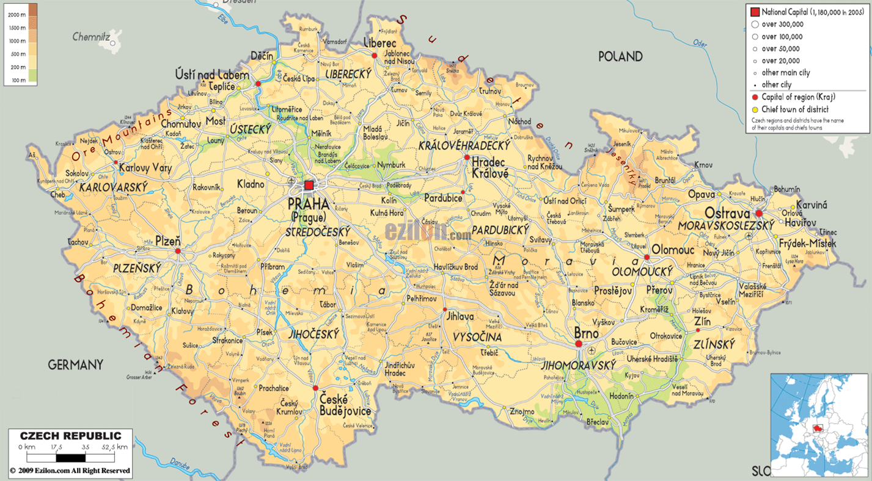
Borders of the Czech Republic
Characterise the borders of the Czech Republic
What is typical?
What is special?

Slide 3

Borders of the Czech Republic

Slide 4
Borders of the Czech Republic
The borders of the Czech Republic are created by mountain ranges in the north, west, south-west, and the east. In the south the border is created by rivers. The borders are 2 290 km long.
They are stable natural borders
They belong to the most stable and oldest borders in Europe

Slide 5
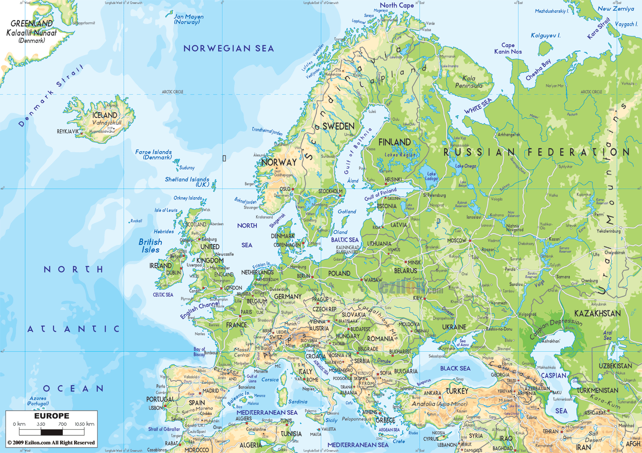
Location of the Czech republic
Characterise the location of the Czech Republic

Slide 6
Location of the Czech republic
The Czech Republic lies in Central Europe or in the heart of Europe
It is an inland/landlocked country without the access to the sea
It is located on the crossroads of traditional trade paths that led from the north to the south and from the east to the west and used natural paths of basins and lowlands along the main rivers

Slide 7
Location of the Czech republic
What are the main advantages and disadvantages of such a location?

Slide 8
Historical development of the country
Give brief characteristics of the historical development of the CR, use the following events and comment on them.
Great Moravia
Otakar II
Charles IV
1920 – 1938
today

Slide 9
Other “boundaries”
What other “boundaries” does the CR lie on?
Explain the following:
  Climate
  Rivers
  Geomorphological provinces

Slide 10
Other “boundaries”
Since the CR lies in the centre of Europe, it also lies in numerous borders and transition zones.
Explain the following:
  A transition zone between temperate oceanic and continental climatic zones
  European watershed
  Bohemian Massive x Western Carpathians

