Slide 1

Climate and Soils
Tematická oblast | The Czech Republic
Datum vytvoření | 4. 6. 2013
Ročník | 2. ročník, sexta
Stručný obsah | Pomocí otázek a vzorových odpovědí se opakuje probrané učivo
Způsob využití | Opakování po probrání učiva; upevnění učiva
Autor | Mgr. Jiřina Juříčková
Kód | VY_32_INOVACE_06_AJUR13
Gymnázium a Jazyková škola s právem státní jazykové zkoušky Zlín

Slide 2
climate
Name the dynamic and unchangeable factors that influence climate. Explain the way they influence the climate.
Explain the term transition zone between temperate oceanic and temperate continental climates. Give main characteristics of each of them and describe the weather patterns during the year in the Czech Republic.

Slide 3
Dynamic factors
Temperature, precipitation, air pressure and winds.
These are given by the actual state of the atmosphere and the positions of depressions or “lows” and anticyclones.

Slide 4
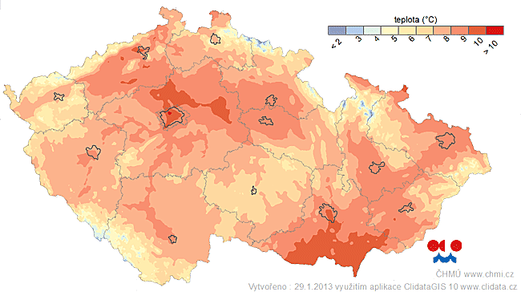
Dynamic and unchangeable factors

Slide 5
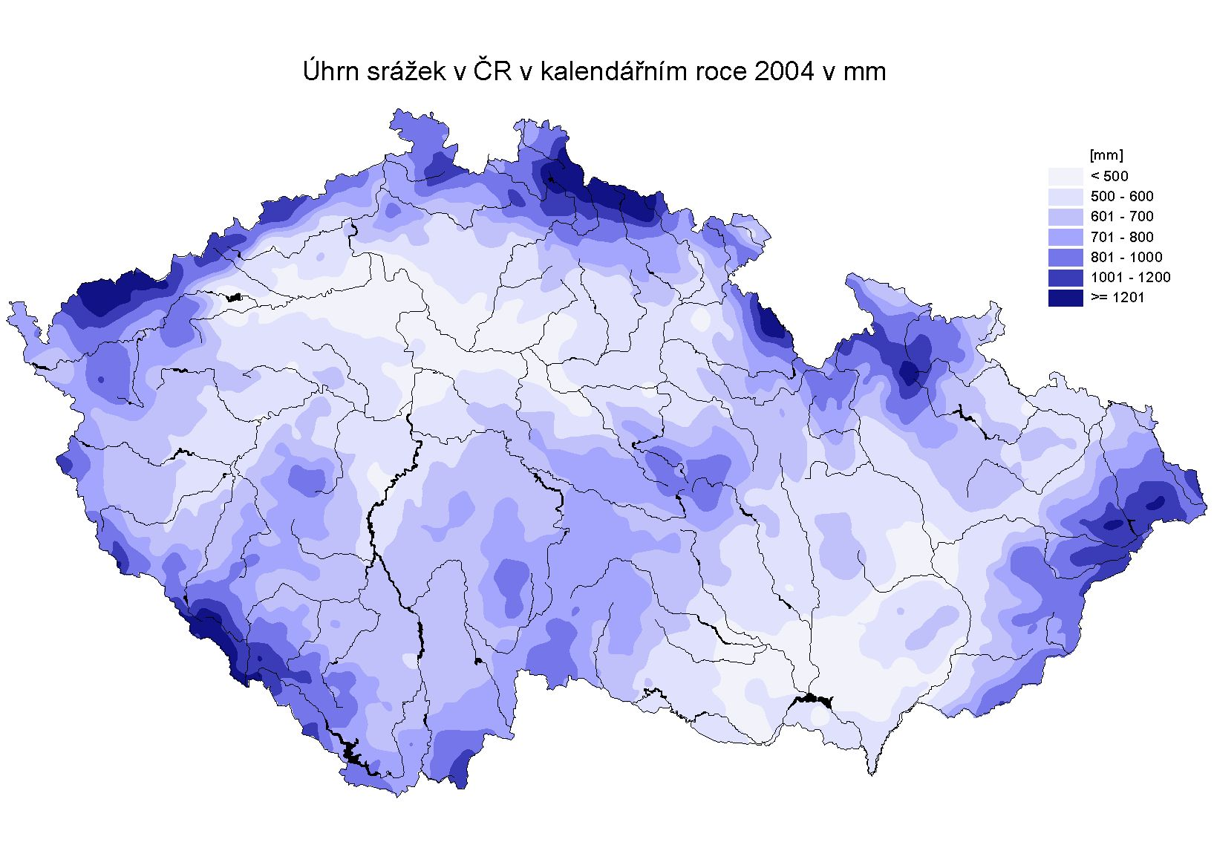
Dynamic and unchangeable factors

Slide 6
Climatic areas of the Czech republic
What are the main climatic areas in the Czech Republic?
According to what are they distinguished?
Use the map on the following slide to help you

Slide 7
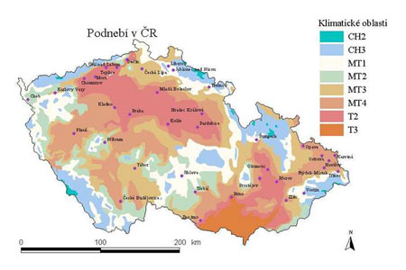
Climatic areas of the Czech Republic

Slide 8
Climate and soils
In what way does climate influence soils?
Temperatures and precipitation have the biggest influence on the formation of soils horizons as they influence evaporation and leaching
The higher the temperature is the bigger evaporation (brings salts and minerals up to the surface)
The higher the precipitation is the bigger leaching (takes salts and minerals down to the B horizon)

Slide 9
sources
http://voda.chmi.cz/hr04/list.html
http://www.in-pocasi.cz/archiv/klima.php
http://www.trasovnik.cz/k_ainfcr/klimapis/klimapis.asp

