Slide 1

Hydrology
Tematická oblast | The Czech Republic
Datum vytvoření | 5. 6. 2013
Ročník | 2. ročník, sexta
Stručný obsah | Pomocí otázek a vzorových odpovědí se opakuje probrané učivo
Způsob využití | Opakování po probrání učiva; upevnění učiva
Autor | Mgr. Jiřina Juříčková
Kód | VY_32_INOVACE_06_AJUR14
Gymnázium a Jazyková škola s právem státní jazykové zkoušky Zlín

Slide 2
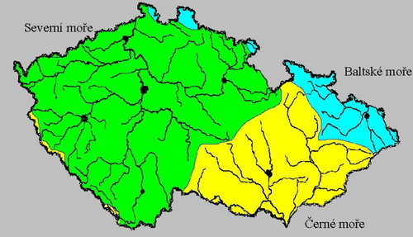
Drainage basins
Use the map below and comment of the drainage basins in the Czech republic
Explain the term European watershed

Slide 3
Drainage basins
There are 3 main ocean drainage basins - the Black sea, the Baltic sea, the North sea
European watershed is the division between the drainage basins

Slide 4
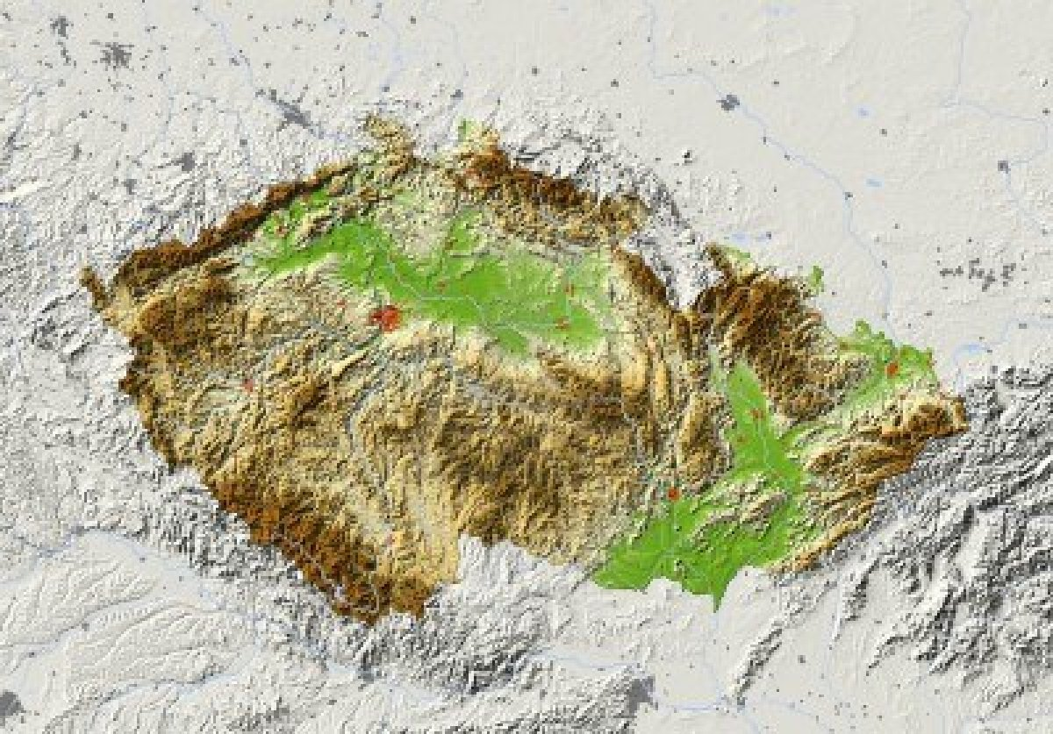
Name the marked rivers
4
12
1
9
5
13
10
8
15
11
14
6
3
2
7

Slide 5
Rivers of the Czech Republic
1 the Elbe
2 the Vltava
3 the Morava
4 the Ohre
5 the Svitava
6 the Jihlava
7 the Dyje
8 the Oder
9 the Berounka
10 the Sazava
11 the Becva
12 the Jizera
13 the Mze
14 the Luznice
15 the Svratka

Slide 6
Lakes in the Czech republic
What different origin are the lakes in the Czech Republic of?
Where can we find them?
glacial lakes - in the Sumava Mts.; were created by mountain glaciers
karst lakes - in the area of Moravian karst
ox-bow lakes - the most numerous lakes in the country; along the rivers
peatbog lakes - in the Krusne and Sumava Mts.; were created in bogs.

Slide 7
Dam lakes and their purposes
What are the main purposes dam lakes are being constructed?
Give examples of some of them.
Energy production
Protective purpose
Irrigation
Drinking water storage
Lipno
The cascade of Orlik, Kamyk, Slapy, and Stechovice
Dlouhe Strane

Slide 8
Sources
http://www.geocaching.com/seek/cache_details.aspx?guid=a7d78704-7e2e-43c6-9da6-00ba2ebe971c

