Slide 1

Agriculture
Tematická oblast | The Czech Republic
Datum vytvoření | 10. 6. 2013
Ročník | 2. ročník, sexta
Stručný obsah | Pomocí otázek a vzorových odpovědí se opakuje probrané učivo
Způsob využití | Opakování po probrání učiva; upevnění učiva
Autor | Mgr. Jiřina Juříčková
Kód | VY_32_INOVACE_06_AJUR17
Gymnázium a Jazyková škola s právem státní jazykové zkoušky Zlín

Slide 2
Agriculture
In what way Czech land resources are divided?
arable land
pasture land
other lands (hop gardens, vineyards, orchards)
What are the main categories agriculture is divided into?
livestock
crop farming

Slide 3
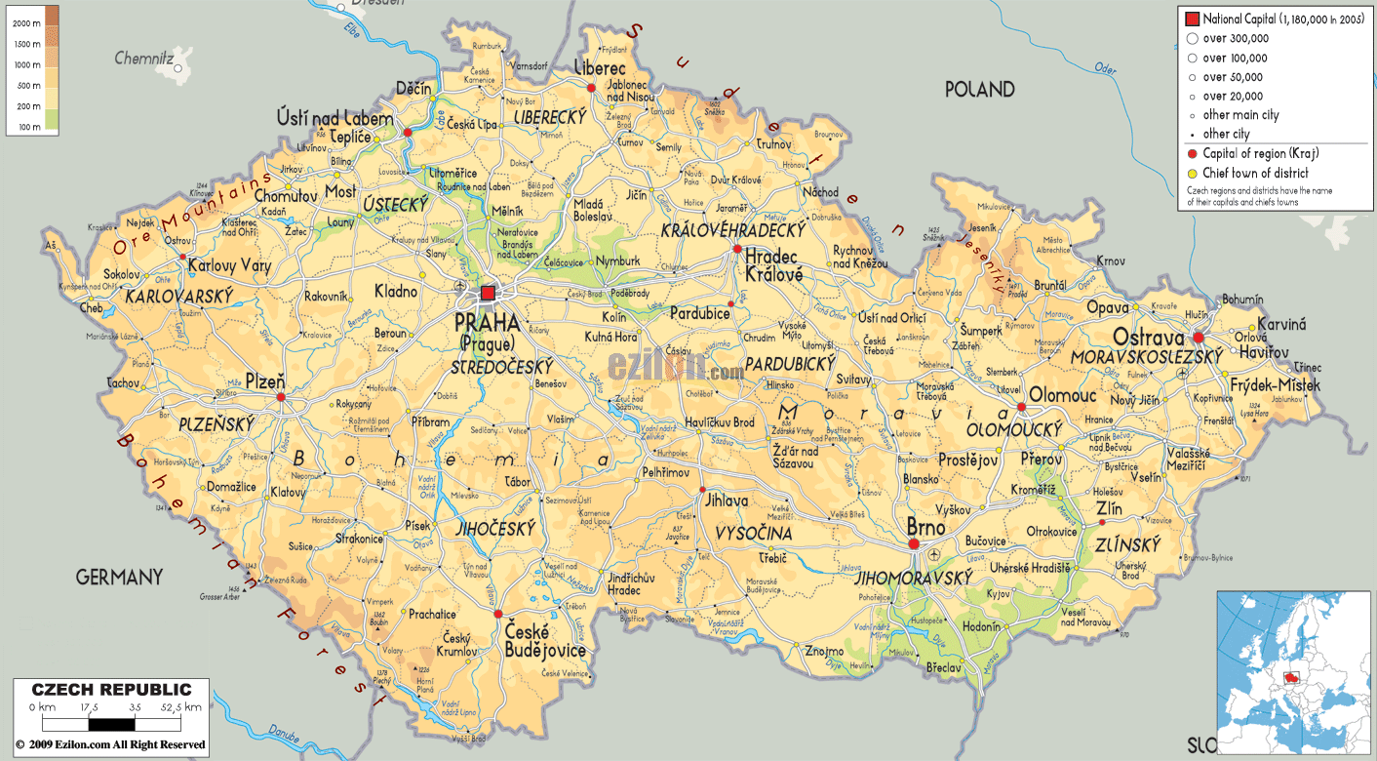
Agriculture producing areas
Use the map in the slide and characterize main agriculture producing areas in the Czech Republic. Try to mark them.

Slide 4


Agriculture producing areas

Slide 5
Agriculture producing areas
Maize - focuses on maize, fruit, vegetables and vine
sugar beet - focuses on sugar beet, wheat, fruit and vegetables
potatoes - focuses on potatoes, oilseed rape, cattle
mountainous areas - cattle, sheep farming

Slide 6
Agriculture producing areas
What are the new trends in agriculture in our country?
Why have they appeared in your opinion?
The new trends are:
Agro-tourism
Ecological agriculture
Bio-production

