Slide 1

Population
Tematická oblast | The Czech Republic
Datum vytvoření | 14. 6. 2013
Ročník | 2. ročník, sexta
Stručný obsah | Pomocí otázek a vzorových odpovědí se opakuje probrané učivo
Způsob využití | Opakování po probrání učiva; upevnění učiva
Autor | Mgr. Jiřina Juříčková
Kód | VY_32_INOVACE_06_AJUR19
Gymnázium a Jazyková škola s právem státní jazykové zkoušky Zlín

Slide 2
Population
Give some main data about the population of the Czech Republic
What does the age pyramid say about the population of the Czech Republic?
What is the population distribution?

Slide 3
Population – basic data
Give some main data about the population of the Czech Republic
  10,177,300 people
  about 63.7% -Czech, 4.9% - Moravian, 1.4% - Slovak
  Czech language -95.4%, Slovak language -1.6%
  non-believers 34.2%, the most widespread church - Roman Catholic - 10.3%
  literacy reaches 99%
  life expectancy is 77.38 years
  73.4% urban population

Slide 4
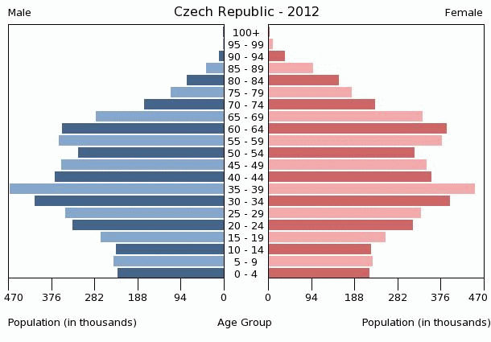
Population – population pyramid

Slide 5
Population – population pyramid
There are quite small numbers of young people up to the age of 19
The age group of people from 20 to 49 is still the largest one
There is a large group of people from 50 to 74
The life expectancy is slightly longer for women than for men

Slide 6
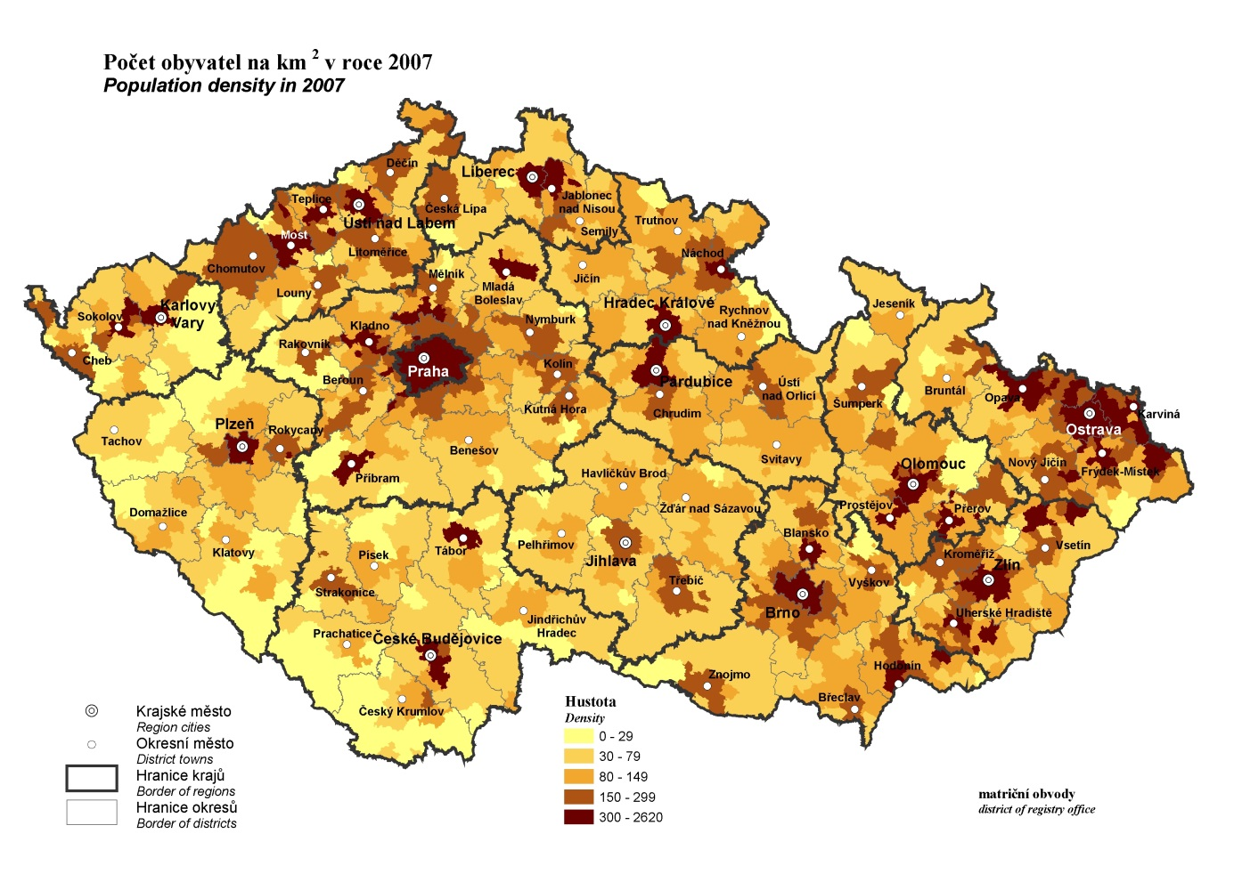
Population – population distribution

Slide 7
Population – population distribution
Population distribution in the Czech Republic is not equal
People live mainly in the areas of large cities – Prague, Brno, Olomouc, Ostrava, Plzen
Then they live in industrial areas – Krusne Mts. Foothills, Ostrava basin
And then they live in fertile basins of Moravia

Slide 8
sources
http://www.indexmundi.com/czech_republic/age_structure.html
http://notes3.czso.cz/csu/2008edicniplan.nsf/engp/1302-08

