Slide 1

Tourism
Tematická oblast | The Czech Republic
Datum vytvoření | 15. 6. 2013
Ročník | 2. ročník, sexta
Stručný obsah | Pomocí otázek a vzorových odpovědí se opakuje probrané učivo
Způsob využití | Opakování po probrání učiva; upevnění učiva
Autor | Mgr. Jiřina Juříčková
Kód | VY_32_INOVACE_06_AJUR20
Gymnázium a Jazyková škola s právem státní jazykové zkoušky Zlín

Slide 2
Tourism
What is tourism?
In which economic sector is it included?
What forms of tourism do we distinguish?
What are the world`s most visited countries?
What are the most visited attractions?

Slide 3
Tourism
Tourism is travel for leisure or recreational purposes
It is included into tertiary industry and it has become the world`s largest growing industry.
They are:
  domestic (residents of the given country travelling only within this country)
  inbound (non-residents travelling in the given country)
  outbound (residents travelling to another country)

Slide 4
Tourism
Most visited countries in the world are:
France
Spain
the United States
China
Italy
All of which have got more than 40 million visitors a year.

Slide 5
Tourism
Among the most visited attractions are (according the Forbes Traveller):
Times Square, New York City, United States,
National Mall & Memorial Parks, Washington D.C., United States
Walt Disney World`s Magic Kingdom, Lake Buena Vista, Orlando, United States
Trafalgar Square, London, United Kingdom
Disneyland, Anaheim, CA, United States
Niagara Falls, Ontario, Canada

Slide 6
Tourism – the Czech republic
Use the map in the atlas of the Czech Republic and comment on tourism in the country:
What are the main areas of tourism?
Where do the tourists come most? Why?
From where do the tourists come to the Czech Republic?
Where do the Czechs go for their holidays?

Slide 7
Tourism – the Czech republic
Use the map in the atlas of the Czech Republic and comment on tourism in the country:
The main areas of tourism in the CR are recreational areas in the mountain ranges (the Krkonose Mts., the Sumava Mts.) and the areas along the Vltava and Sazava rivers.
As for the sights there are historical cities such as Prague, Brno, Cesky Krumlov, Kromeriz, Velehrad and many others.
Tourists come mainly to Prague (sightseeing, culture), spa towns in the North-western Bohemia (health) and to the area of the Krkonose Mts. (sports)

Slide 8
Tourism – the Czech republic
Mainly from Germany and Russia, then from Poland, Slovakia, Italy and Great Britain
The Czechs most often go to Croatia (almost 800 thousand), then Italy, Slovakia (more than 500 thousand) and Greece, Austria, Spain. Among other popular destinations Egypt, Tunisia and Turkey can be named.

Slide 9
UNESCO sites
In the Czech Republic there are also places listed on the UNESCO list of the world`s heritage. Can you name some of them?
  Prague – historical centre
  Kutna Hora – historical centre
  Holasovice – folk architecture
  Cesky Krumlov – historical centre
  Telc – historical centre
  Zelena Hora – pilgrimage place (church)
  Terbic – Jewish town
  Brno – Tugendhat villa
  Olomouc – column of the Saint
  Kromeriz – castle and gardens
  Lednice area – chatteaus` parks and gardens

Slide 10
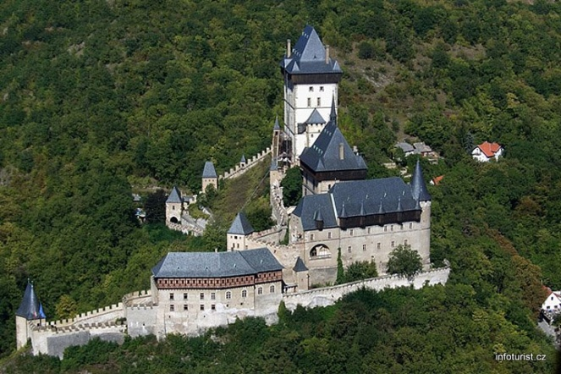
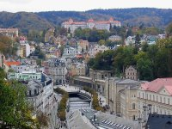
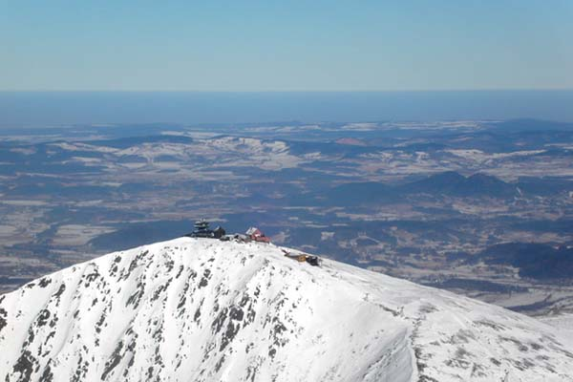
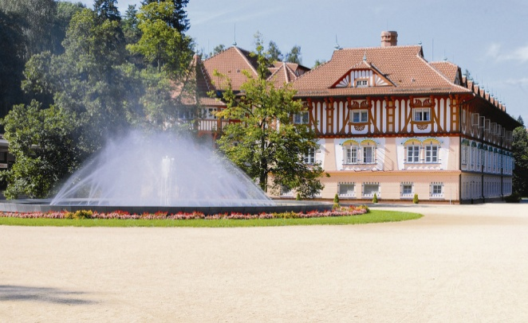
Identify the places
Can you identify the places in the photos?

Slide 11
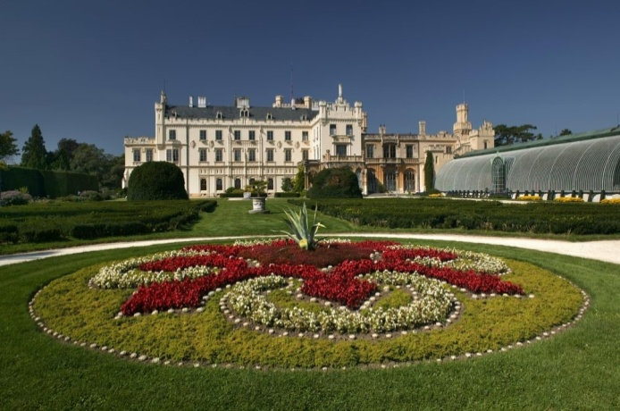
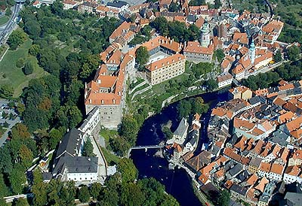
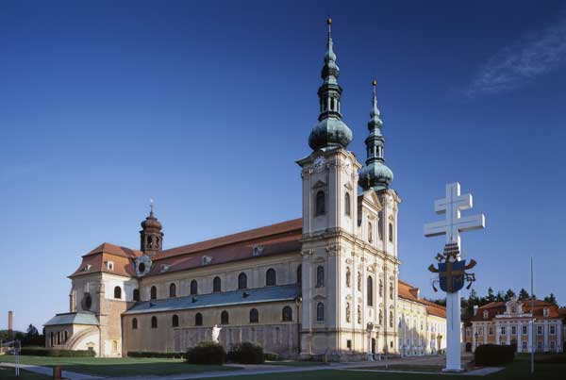
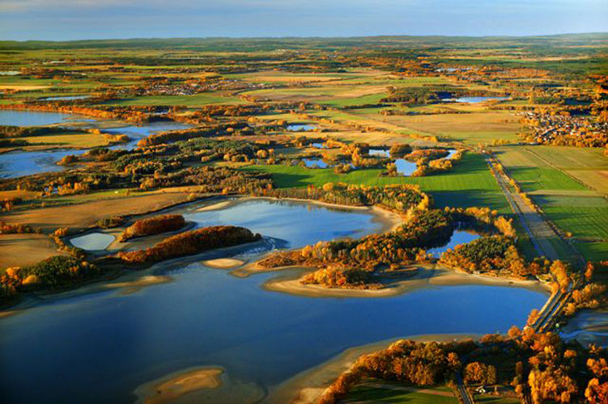
Identify the places
Can you identify the places in the photos?

Slide 12
http://www.cz-pamatky.cz/2009/07/karlstejn
http://www.czech-transport.com/index.php?id=57
http://www.blesk.cz/clanek/radce-prazdninovy-inspektor/139603/lazne-luhacovice-muzete-tu-byt-i-na-zkousku.html
http://www.snezka.net/
http://www.lednice.cz/en/
http://www.mestozlin.com/index.php?page=detail&id=2010&co=aktualne
http://www.visitjiznicechy.cz/cz/prirodni-pamatky/6/2/

